Slide 1
Clean Energy Means Cleaner Air

Slide 2
Carbon-based Power
Carbon based power comes from burning of fossil fuels, which produces air pollutants, especially ground level ozone and small particles. These pollutants are harmful to the lungs and heart. Nearly everyone in the U.S. knows someone with a heart or lung condition.

Slide 3
Air pollutants come from several sources:
Ozone at the ground level increases in warmer weather, forming when exhaust from the burning of fossil fuels reacts with heat + light
Particulate matter comes from:
Emissions from burning fossil fuels in power plants, industrial processes and vehicles
Dust
Fires
Pollen

Slide 4
Health Effects of Air Pollutants
Ozone
Directly irritates the lungs
Particles (< PM 2.5 u)
Small particles get deep into the lungs
Produce inflammation
Are associated with:
Worsening heart disease
ER visits/hospitalization
Poor lung development in children

Slide 5
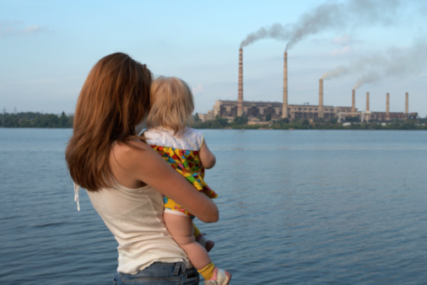
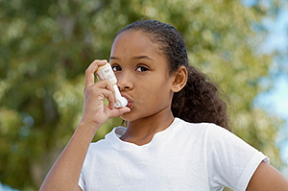
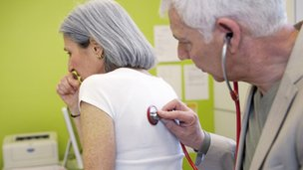
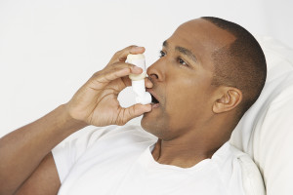
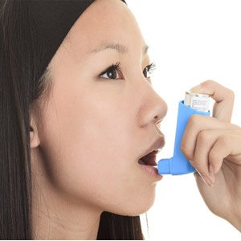
Pollutants can harm people of all ages
Reducing them is better for everyone’s health
Notes:
In addition to its nutritional impact on our health, the emissions from production add to global warming, which has further health impacts on food and water. second largest source of methane are animals we raise for meat and dairy, with each cow producing over 1000 liters/d. The third is decay of wasted food in landfills

Slide 6
Reducing air pollutants reduces demand for healthcare:
The 1996 Summer Olympics were in Atlanta, GA:
Traffic restrictions led to a 23% decrease in peak a.m. traffic
Ozone levels decreased 28%.
Emergency room visits for children with asthma decreased 42%.
Children’s emergency room visits for causes other than asthma did not change.
Friedman MS, Powell KE, Hutwagner L, et al. Impact of changes in transportation and commuting behaviors during the 1996 Summer Olympic games in Atlanta on air quality and childhood asthma. JAMA 2001;285:897-905.
Notes:
Prospective studies show that high consumption of red meat significantly increases risk of new onset DM and deaths from cancer, CVD controlling for other risk factors.

Slide 7
The benefit of clean renewable energy:
Reducing the burning of fossil fuels for energy and switching to clean renewable sources creates immediate improvement in air quality (less ozone and particles), bringing immediate improvement to lung and heart health. This reduces the demand for medical care. Note that reducing power generation through energy efficiency has the same benefits.
Notes:
Prospective studies show that high consumption of red meat significantly increases risk of new onset DM and deaths from cancer, CVD controlling for other risk factors.

Slide 8
Using clean renewable power (low carbon, low fossil fuel) leads to improved health
Notes:
Prospective studies show that high consumption of red meat significantly increases risk of new onset DM and deaths from cancer, CVD controlling for other risk factors.

Slide 9
What can you do?
Help people find out about the air quality where they live and work
Everyone can check the air quality online at:
Air Now: www.airnow.gov
App (Platform: Apple, Android, Web): https://developer.epa.gov/airnow/
State of the Air – By American Lung Association
Apple app: https://itunes.apple.com/us/app/state-of-the-air/id522123660?mt=8
Android app: https://play.google.com/store/apps/details?id=com.reddeluxe.sota&hl=en
Notes:
Prospective studies show that high consumption of red meat significantly increases risk of new onset DM and deaths from cancer, CVD controlling for other risk factors.

Slide 10
What can you do?
Advise caution on hot weather days since air quality will be worse, especially for those with a heart or lung condition.
If ozone is in the red zone, being inside is best; consider the same avice for code orange.
If there is a lung condition, exercise is best avoided even during code yellow.
If there is heart disease and particulates are high, (codes yellow, orange, or red) advise should be to stay inside.
Notes:
Prospective studies show that high consumption of red meat significantly increases risk of new onset DM and deaths from cancer, CVD controlling for other risk factors.

Slide 11
