Slide 1
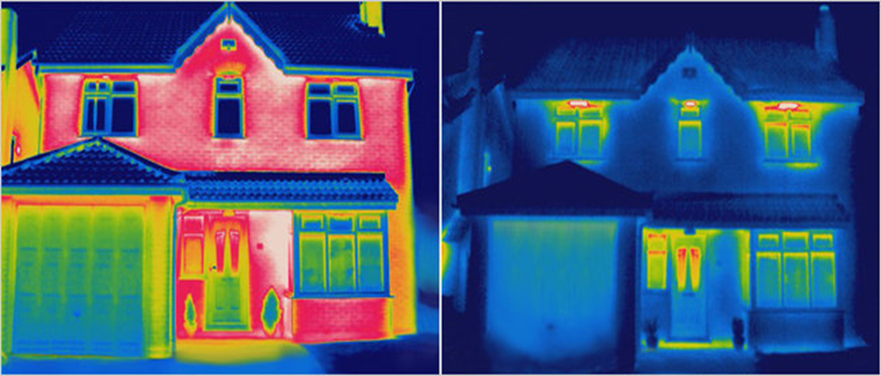
Improve Energy Efficiency
Heat Escapes
Little Heat Escapes

Slide 2
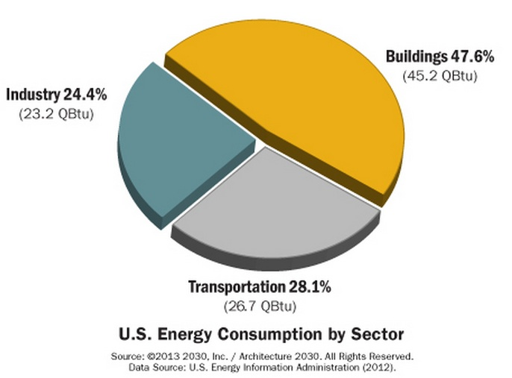
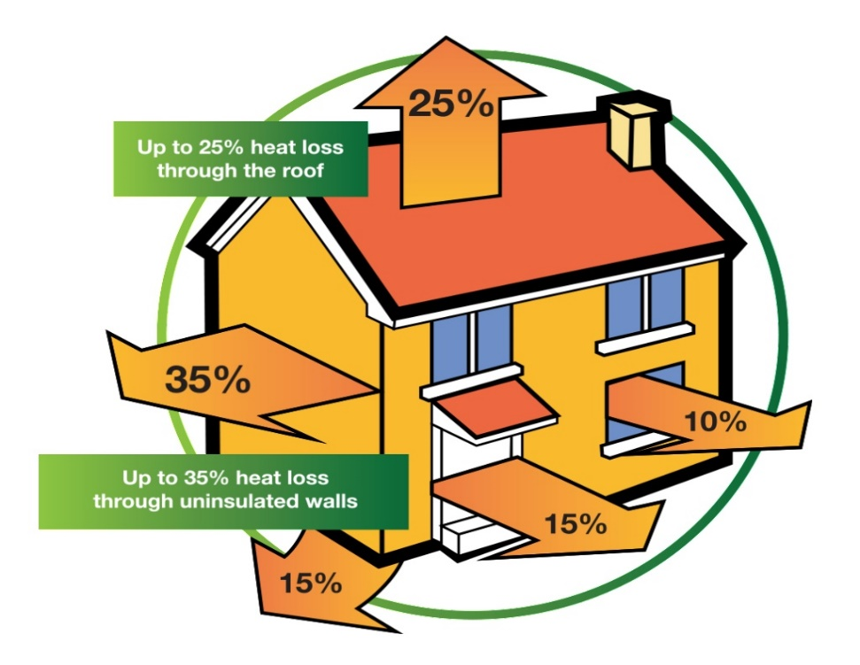
MORE EFFICIENT HOMES AND BUILDINGS
Efficiency reduces energy use and thus power production and saves money.
Notes:
STOPPING WASTE AND IMPROVING ENERGY EFFICIENCY IS
THE LOW HANGING FRUIT.
THESE ARE THE ACTIONS BELOW COST CURVE
THAT SAVE MONEY
Buildings use up 40% of our energy and nearly half is wasted.
Basic energy retrofits (seal leaks, insulate)
can decrease energy use 30-40% and save $3 for every
Dollar invested.

Slide 3
More for Your Money
Generate Savings. Technology upgrades to improve the way your home, building, or business functions typically require some up-front investment. Investments in new systems, better lighting, and insulation lower energy bills. In fact, many types of efficiency upgrades can generate savings for decades!
Helping those who need it most. Improving energy efficiency benefits everyone, but especially those who most need to reduce the risk of having to pay volatile energy prices: people on fixed or lower incomes. A wide variety of programs are offered by the federal government, states, utilities, and local municipalities to ensure that energy efficiency upgrades are affordable and available to those who need them most.

Slide 4
Helping the local economy
Some investments, such as insulation in an attic or replacement of an air conditioner, require the help of a specialized installer. This creates local jobs. Further, the money that is saved on utility bills goes back into the pockets of home and business owners. This “extra” money creates even more jobs when it gets spent by families for urgent needs or life’s little luxuries, and by local businesses for expenses and growth.

Slide 5
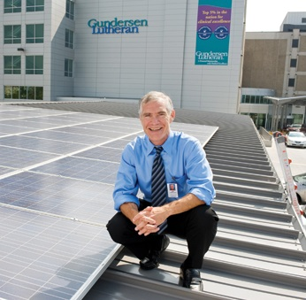
Jeffery Thompson MD, Gundersen Lutheran Health System, LaCrosse, WI
Some health systems are at the leading edge!
Notes:
Geoffrey Thompson is a neonatalogist and the CEO of Gundersen Lutheran Health System, a nonprofit healthcare network with 4 hospitals and 75 clinics serving patients in Iowa, Wisconsin, and Minnesota. Hospitals are among the most energy intensive buildings in the US and back in 2007 Gundersen had to raise patient bills due to energy costs rising by $350,000 per year. “We asked ourselves, "Why are we here?" To improve the health and well-being of patients and our communities and if we're going to do that, we need to stop causing harm., and part of the community's need is that we keep the cost of health care down. So, we said we're going to decrease our impact on the environment and lower the cost of health care at the same time”.

Slide 6
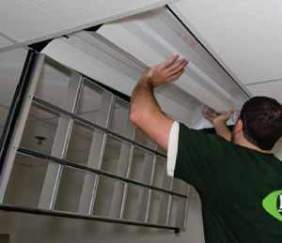
Gunderson Hospital achieved $1 MILLION ANNUAL SAVINGS from improved EFFICIENCY
Notes:
They began by optimizing heating, cooling, and lighting and changing employee behavior to reduce energy demand. Within 2 years the hospital's energy use had dropped 25%, saving $1 million dollars a year. They now save $2 million annually.
They didn't talk about climate change.
Jeffrey: I didn't want people focusing on the debates of which news station they watch and get wound around that axle.That's why we framed it as pollution, which causes people with lung disease to breathe hard. We shouldn't allow that to happen. We shouldn't put mercury into the environment. We should not waste food. We stressed these kinds of things. If we can produce energy locally and help the local economy, we should do that.

Slide 7
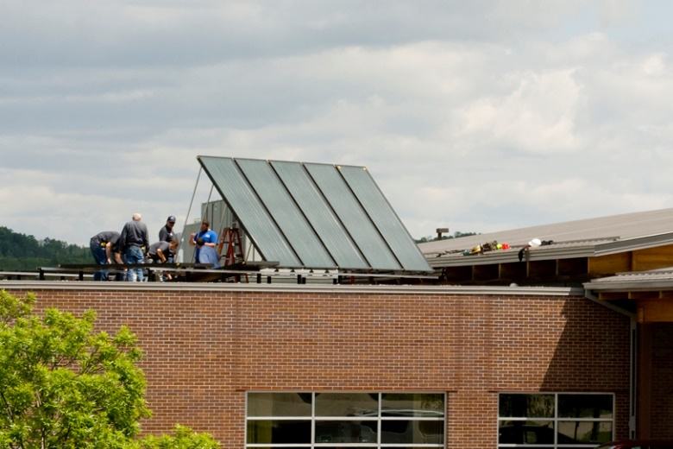
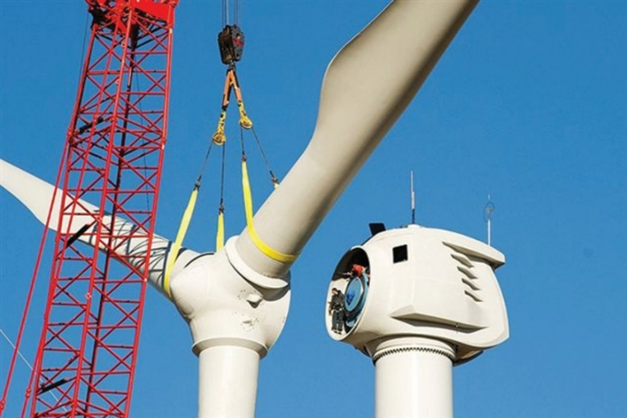
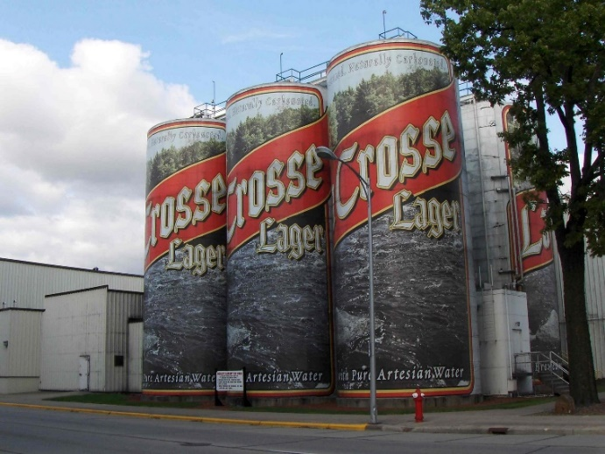
Gunderson is now powered by 100% clean energy
Notes:
And over the next 5 years Gundersen added renewable energy generation including solar, wind, geothermal, and waste biogas from local dairy farms, the city landfill, and a local brewery. Jeffrey: We developed a plan to invest locally in energy production rather than putting our money in treasury notes, stocks or bonds. Now we have our business community, our education community, our staff believing that we can do more than one thing at a time; that we can take care of patients and the community while we save money with our sustainability program. The hospital is on track to achieve its goal of running on 100% clean safe energy by the end of this year.

Slide 8
Private Homes
Home owners can approach energy in three ways.
Since electricity accounts for one third of greenhouse gas emissions, reducing energy use will reduce output of carbon
Improved efficiency can reduce energy use by 25-40
Think better insulation, use of LED light, programmable thermostats
Clean renewable energy may be easier than you think:
You can purchase solar or wind energy from providers in many areas
You can install solar panels on your home (see if there are rebates in your area to bring down the cost)

Slide 9
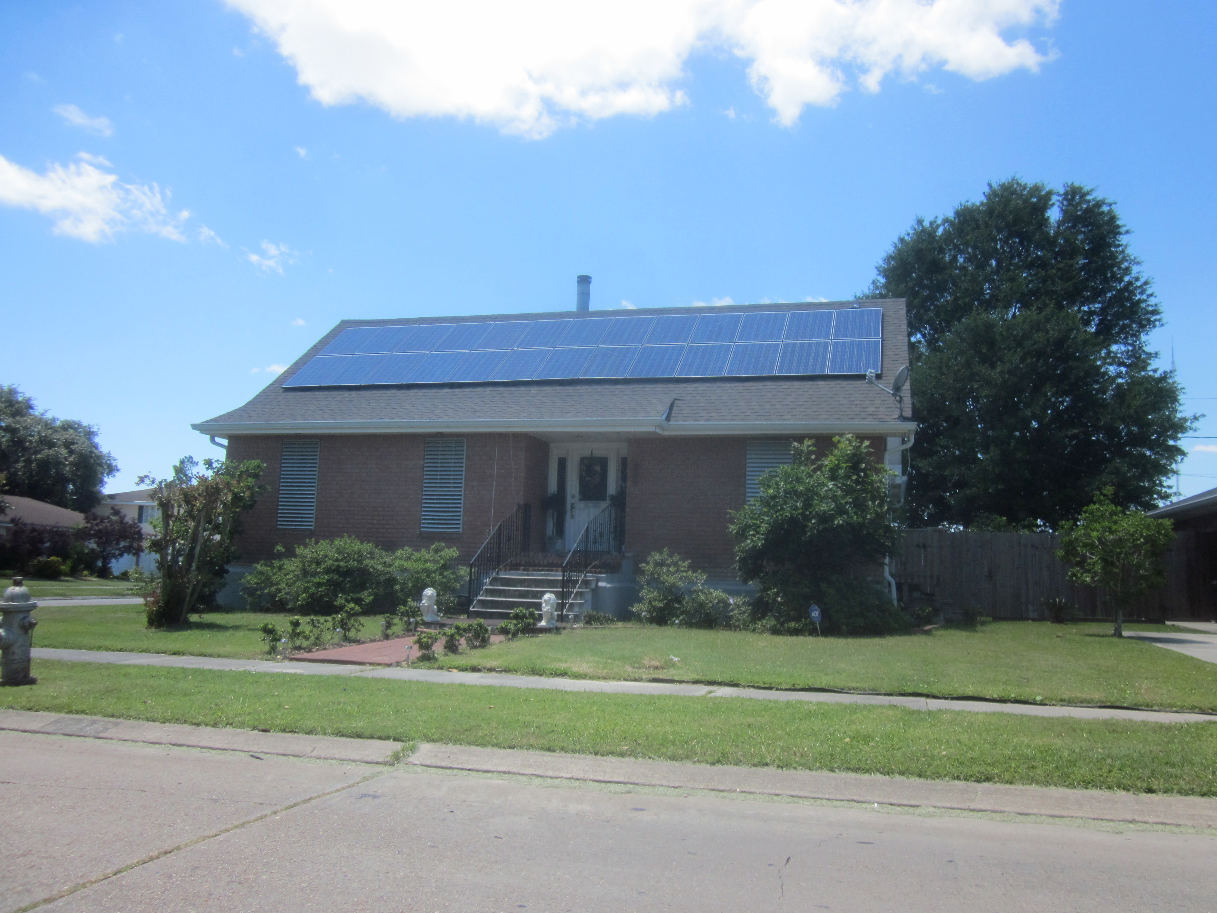
Private Homes Can Make the Transition

Slide 10
Private Homes Can Make the Transition

Slide 11
Energy Efficiency
Sounds too easy, but in fact it could make a huge difference
Energy efficiency is all about using technology and best practices to produce the same or better levels of services, such as light, temperature control, or motor drive power, while using less energy. Very simply, it’s about reducing waste.
Using only technology which is currently available, the U.S. could be reducing power use by 25-40%
Heating/cooling is usually 50% of home power use, lighting is 25%, other appliances make up the rest.

Slide 12
Is it Pie in the Sky?
Consider this:
1879 Thomas Edison demonstrated the incandescent
light bulb; by 1900 all NYC was lit
The technologies are available. We can use them.
N.B. Anti-competitive obstacles to clean power and new technologies should not be permitted to develop.

Slide 13
Everyone can make a Difference Thank You!

