Slide 1
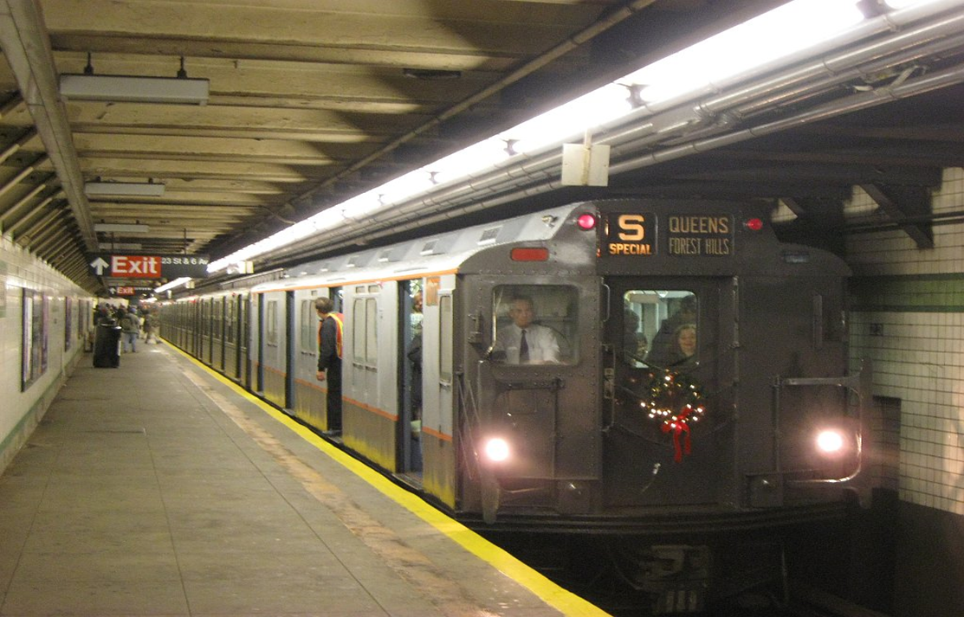
Transportation Makes a Difference

Slide 2
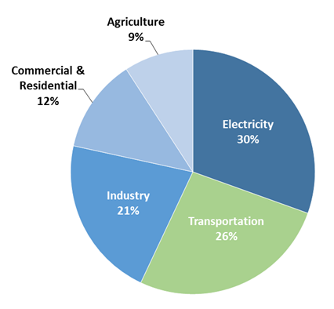
Total U.S. Greenhouse Gas Emissions by Economic Sector in 2014
Greenhouse gas emissions from transportation account for more than a quarter of total U.S. greenhouse gas emissions, making it the second largest contributor of U.S. greenhouse gas emissions.

Slide 3
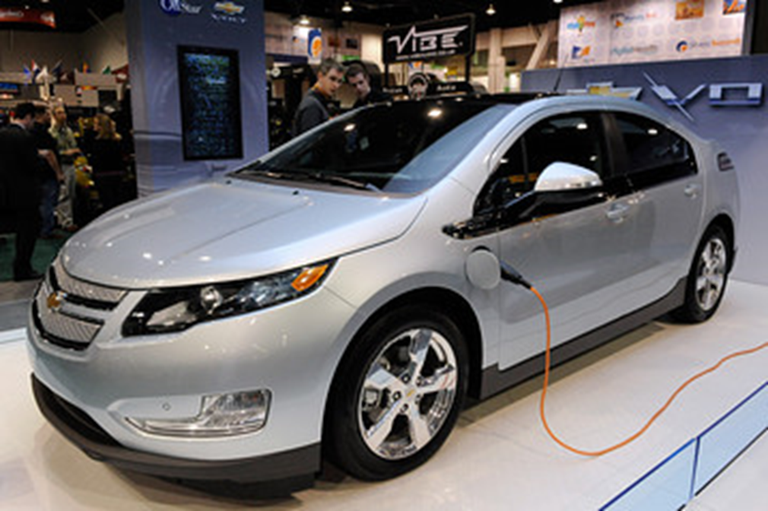
Non-polluting electric cars offer benefits for the environment: they produce no air pollution or additional greenhouse gas.

Slide 4
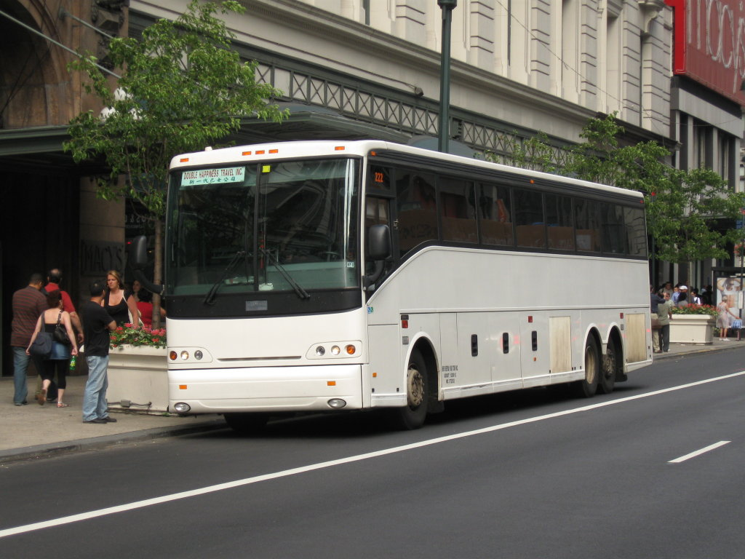
Low carbon transportation, such as walking, biking, and public transit, are climate change solutions with health benefits for the traveler and the environment.

Slide 5
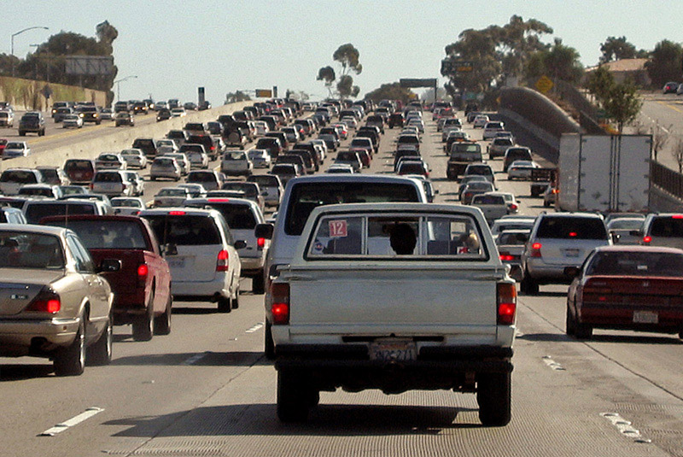
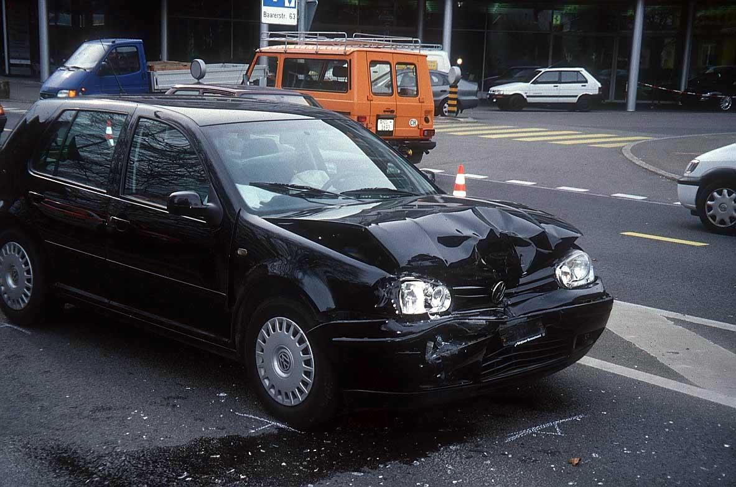
Car trips have disadvantages
- 40% of trips by car are brief: < 1.8 mile
- Walking or biking could replace them.

Slide 6
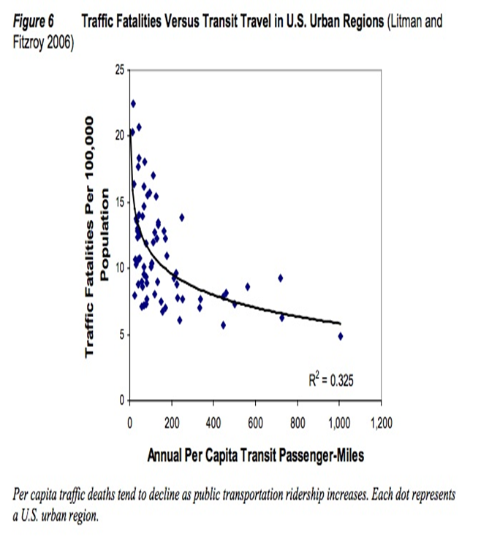
Mass Transit Use Decreases Vehicle Accident Deaths
Fewer traffic deaths with more public transit:

Slide 7
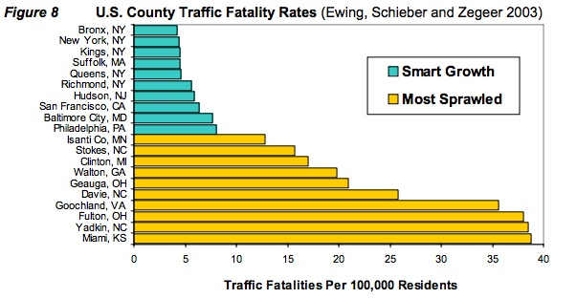
Fatalities in Smart Growth vs Sprawl

Slide 8
Physical Inactivity Contributes to Poor Health
Sprawl and disconnected street networks are associated with increased rates of obesity, diabetes, heart disease (Marshall, 2014).
Residents of “walkable” metro areas walk more & use more public transit. They have less obesity, lower blood pressure, less diabetes, and 3 years longer life expectancy than people living with sprawl (Ewing, 2014)
Users of public transit are 45% less likely to be obese or overweight (Zheng, Y. 2008)

Slide 9
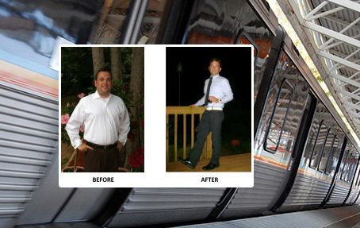
Sam Moody – Atlanta, GA
Gave up his car, took public transportation, increased his exercise, and lost 70 lbs. in less than one year

Slide 10
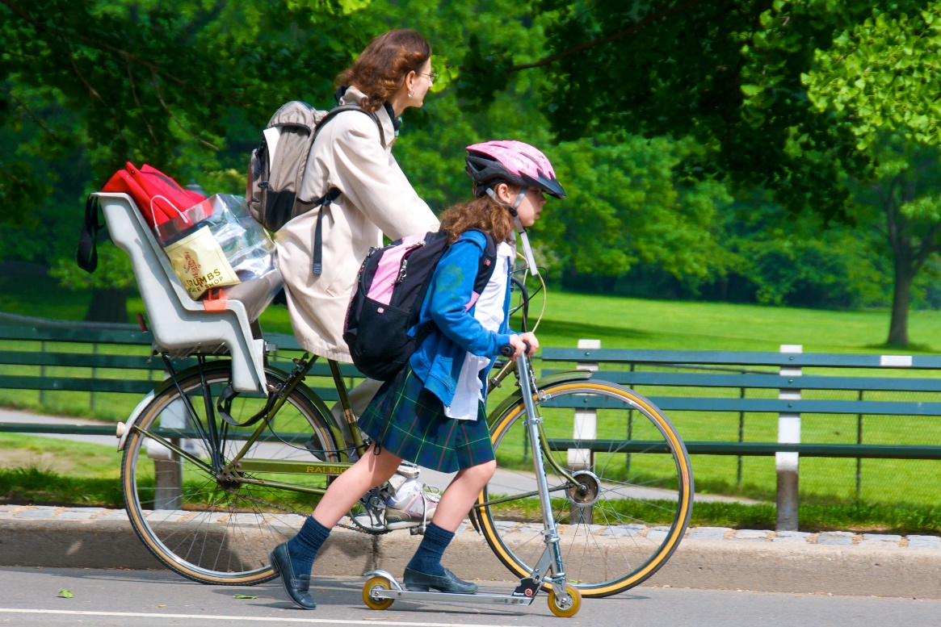
Active Transportation
Active transportation is any self-propelled, human-powered mode of transportation, such as walking or bicycling.
Active transportation –such as walking or cycling--or going with public transportation– is a healthier alternative for short trips.

Slide 11
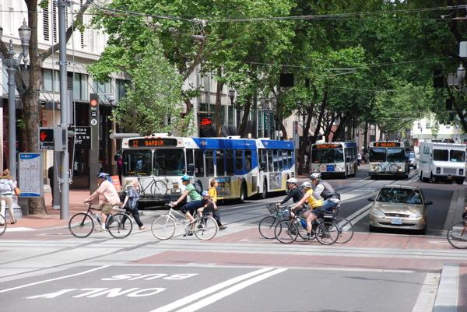
Policy Recommendations: on Public Transportation
• “Smart growth” means walkable communities with public transportation infrastructure
• Better infrastructure near transit stops offers better walkability.
• Coordination between agencies and levels of government is needed to achieve success.

Slide 12
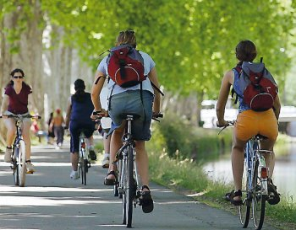
Policies that Encouraging Active Transport
• Allow for separation of motor-vehicle from non-motorized traffic and physical barriers for better safety
• Establish bicycle parking at workplaces and transit stops
• Provide safe routes for children to walk/bike to school
• Develop connected networks of multi-use bike/walking trails
• Offer education for bicyclists and pedestrians on state and local laws, and safe practices

Slide 13
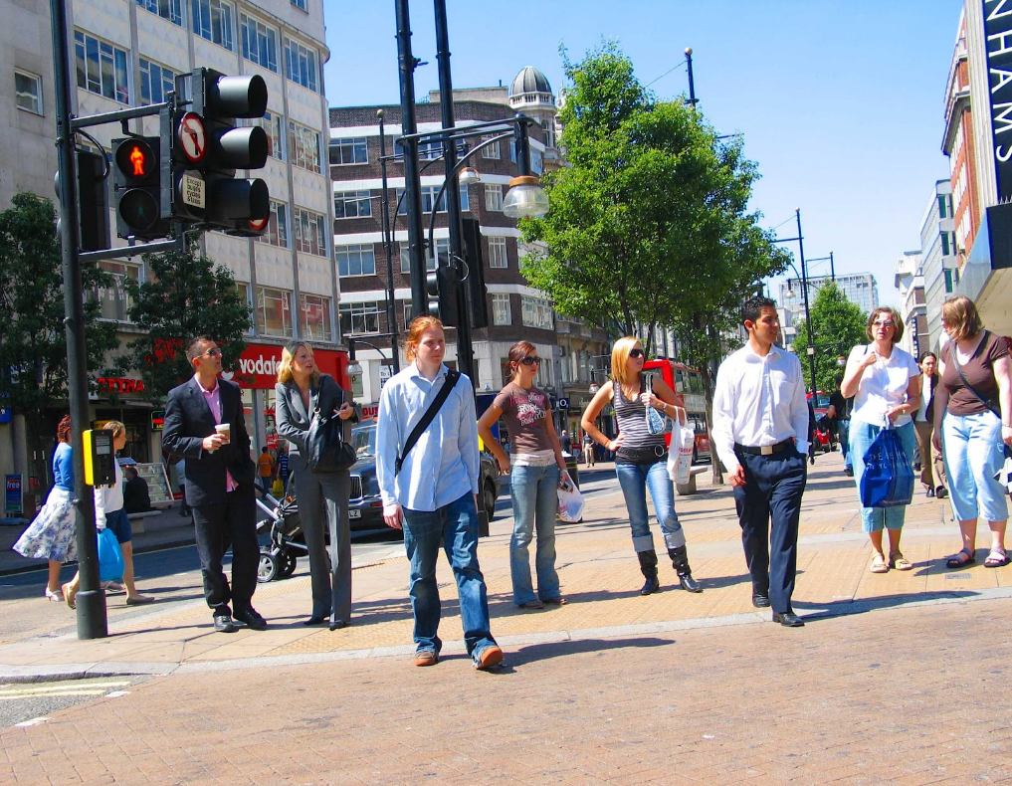
Build Walkable Communities
With safe and accessible roadway crossings through use of small block sizes, pedestrian refuge islands, and cross-walks
With streetscape amenities such as benches, landscaping, and lighting
With street-level restaurants and shops along pedestrian and bicycle routes

Slide 14
Are these societal changes even possible?
Consider this:
In 1879 Thomas Edison demonstrated the incandescent light bulb; by 1900 all NYC was lit
In 1990 only 2% of U.S. adults owned a basic cell phone and the vast majority had either never heard of the internet or were very vague on the concept; Now over 90% are both connected to the internet and own mobile devices
Rapid innovation toward low-carbon transportation solutions is possible!

Slide 15
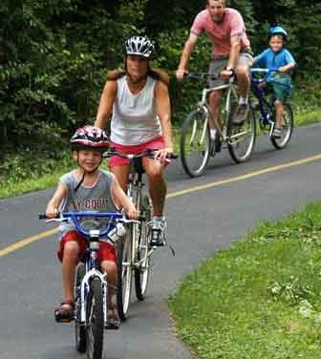
What can you do?
When possible, walk or bike ride to your destination rather than drive in order to reduce the number of vehicle miles traveled.
For car trips, consider an electric car.
Consider a car pool.
Learn techniques for how to operate your vehicle more efficiently and reduce greenhouse gas emissions
Advocate for policies that support the development of walkable communities and safe/accessible public transpiration

Slide 16
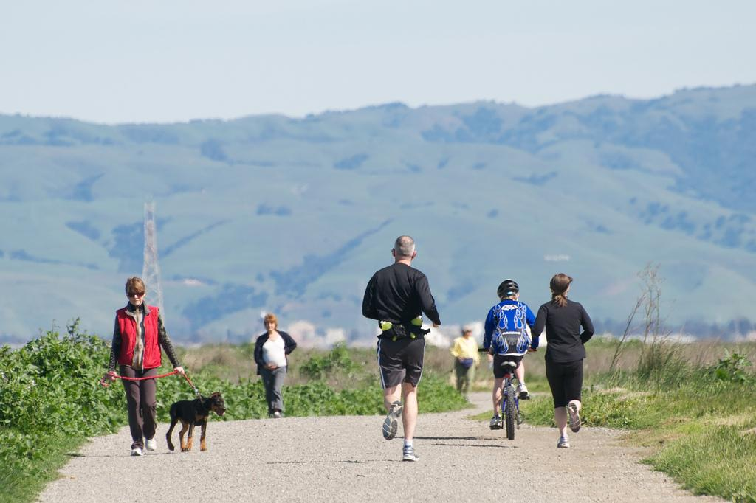
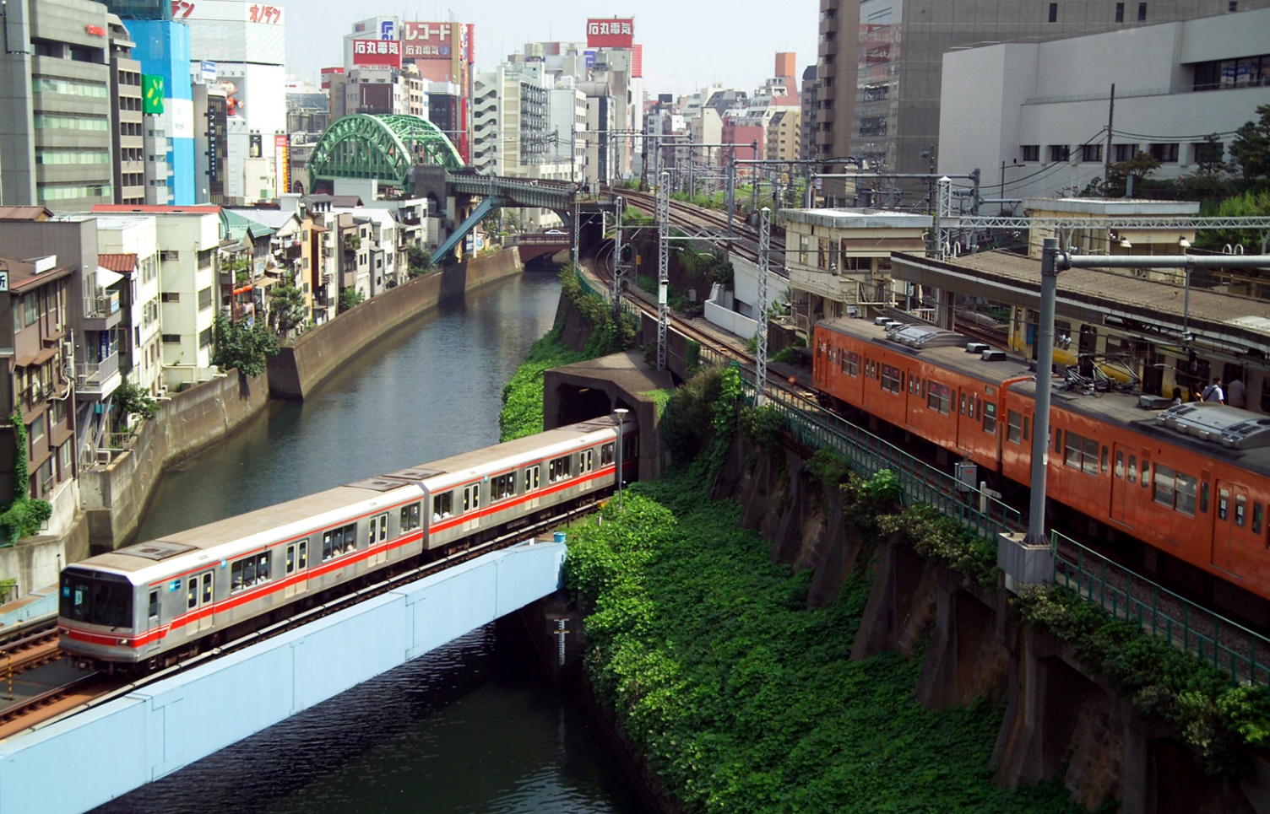
Healthier Transportation Solutions
Better for the environment.
Better for people.

