Slide 1
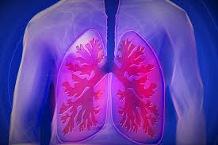
What Physicians Can Do about Air Pollution, Climate Change, and Lung Health
Program on Climate and Health
George Mason University Center for Climate Change Communication (Mason 4C)

Slide 2
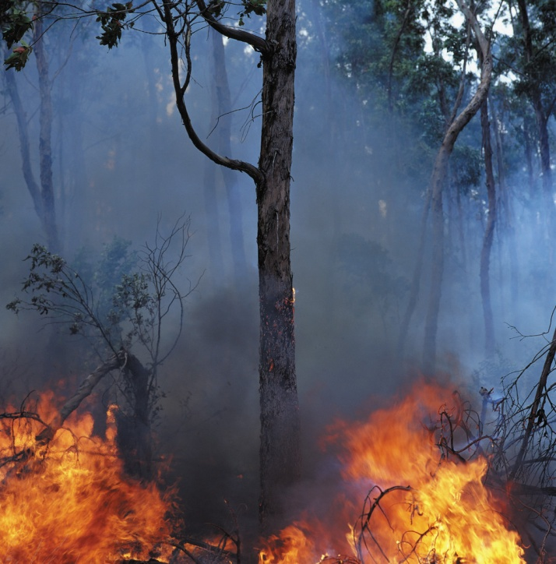
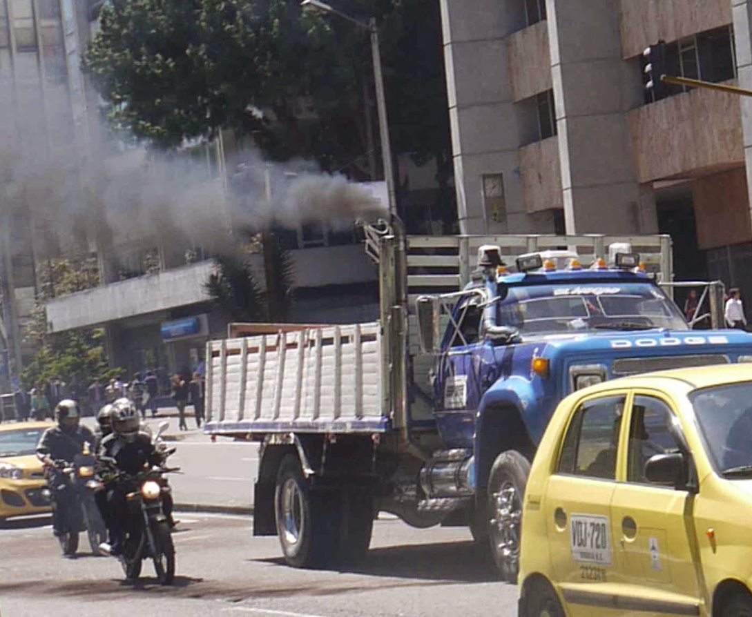
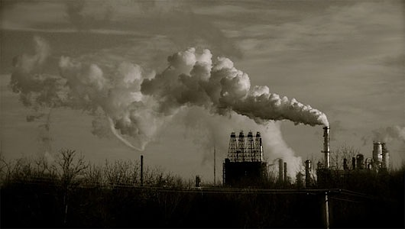
Health Effect: Air Pollution
Notes:
http://www.mnn.com/earth-matters/wilderness-resources/stories/25-states-urge-court-to-make-epa-delay-power-plant-rule

Slide 3
What are Components of Poor Air Quality?
Ozone (visible as smog)
Particulate matter – small particles especially (get into lungs)
Diesel trucks and automobiles
Fires
Dust
Power Plant emissions
Pollen - particles with allergenic effect
All made worse with hot weather because heat + light turn fumes into ozone. Hot days are increasing due to climate change, which also causes more robust pollen growth!
See the Official American Thoracic Society Workshop Report: Climate Change and Human Health. Pinkerton KE, et. al. Proceedings of the American Thoracic Society. 2012, Vol.9: 3-8.

Slide 5
Pathogenesis: Ozone irritates the lungs and makes people more vulnerable to the effects of small particles and allergens.*
(*Rom WN, et al. Global Warming: A Challenge to all American Thoracic Society Members. Am J Respir Crit Care Med 2008; Vol 177: 1053-1057.)

Slide 6
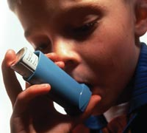
Take home message: air quality worsens with climate change
Particles: linger with stagnant air; smoke increases with forest fires.
Ozone is worse when it is hot (summer afternoons especially)
Allergens are increasing with warmer temperatures
About 10% of the U.S. population has either Asthma or chronic lung disease
Heat & air pollutants cause worsening symptoms,
more ER visits and hospitalizations
http://ephtracking.cdc.gov/showAsthma.action
Franchini & Mannucci, 2015; GOLD, 2015; Halonen et al., 2009

Slide 7
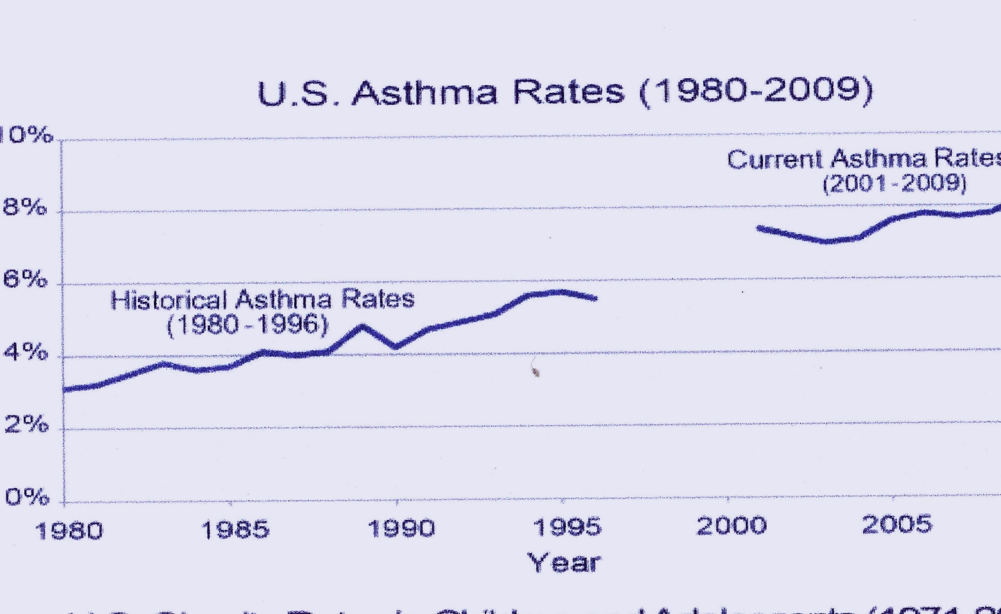
AIR QUALITY
Asthma Prevalence is Rising
Health Chapter. National Climate Assessment. US Global Change Research Group, 2014.

Slide 8
What can clinicians do as part of clinical care?
Properly understand the symptomatology
Chronic persistent (mild, moderate, severe)
Intermittent
Appropriate medication management
Indoor exposures and environment
Allergy triggers
Include outdoor air quality (AQI) in clinical management and help patients use the information
“AirNow.gov”; See the Air Quality Report Card “Lung.org”
“State of the Air” smart phone app, real time air quality by zip code

Slide 9
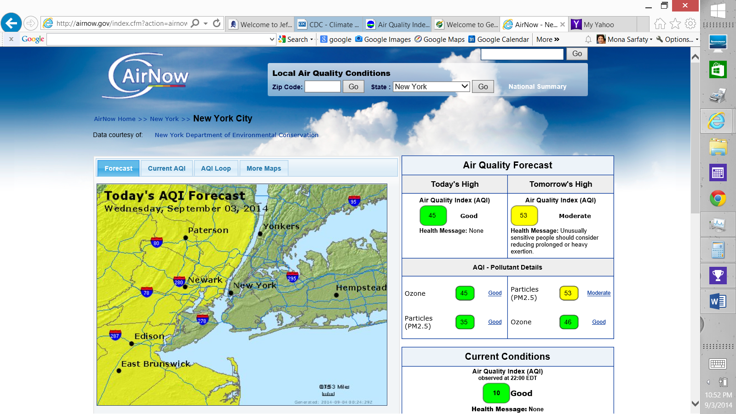

Slide 10
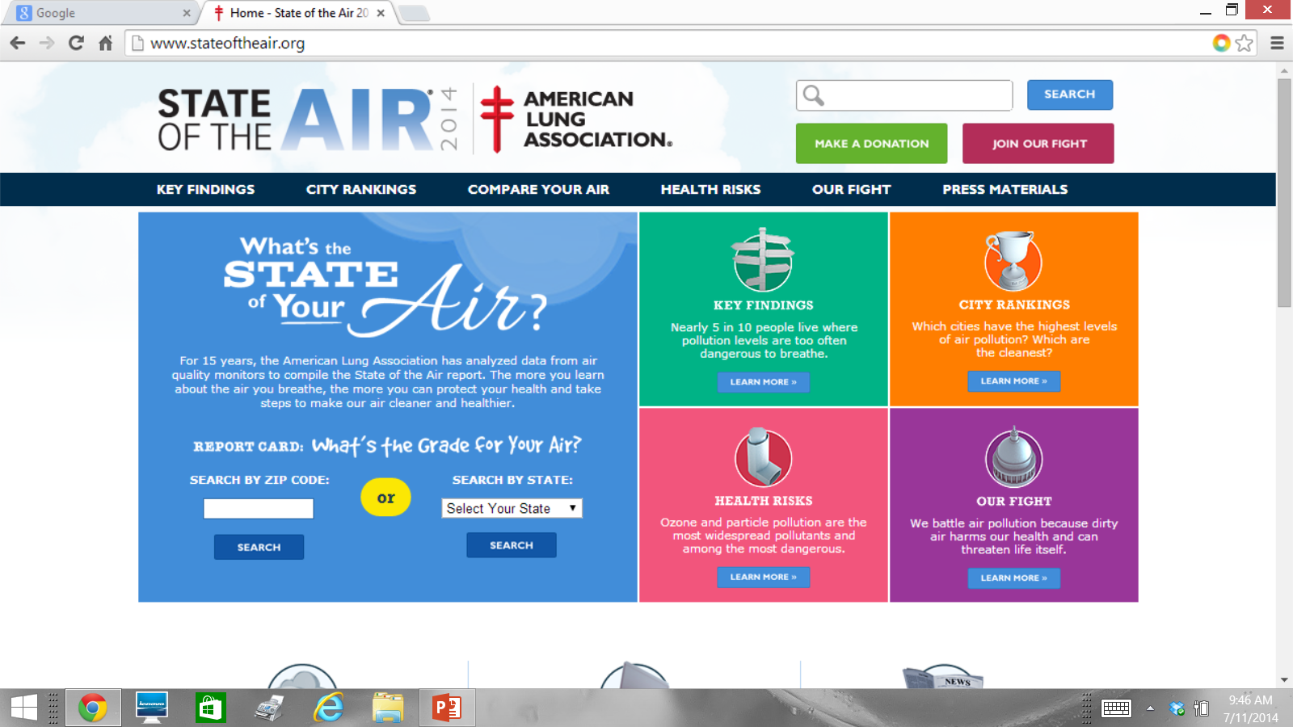

Slide 11
What Can Clinicians Do on Public Policy?
Sources of Air Pollution are also Sources of Greenhouse Gases (GHG)
Power plants produce >33% of greenhouse gas output *
Two aspects of the same problem - power generation has direct
unhealthy effects and contributes disproportionately to warming.

Slide 12
Power Plants, a Public Policy Opportunity
The EPA Clean Power Plan Rule
Would increase efficiency of existing power plants and limit carbon pollution (carbon dioxide output)
New power plants were addressed in prior regulations
Each state sets a course to reduce output based on 2012 baseline
Physicians can spread the word about how important this is
To find out what is happening in your state go to:
http://www.eenews.net/interactive/clean_power_plan

Slide 13
Thank You!

