Slide 1
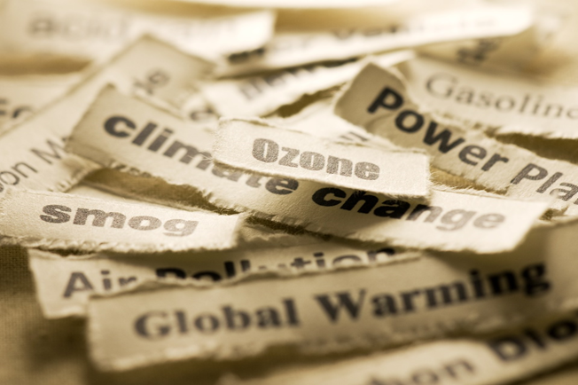
CLIMATE HEALTH SUMMIT
Climate Change & Air Pollution
Yolanda Whyte, MD

Slide 2
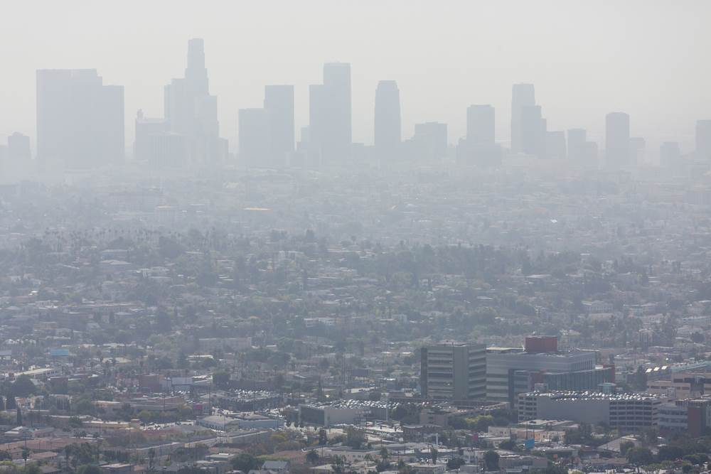
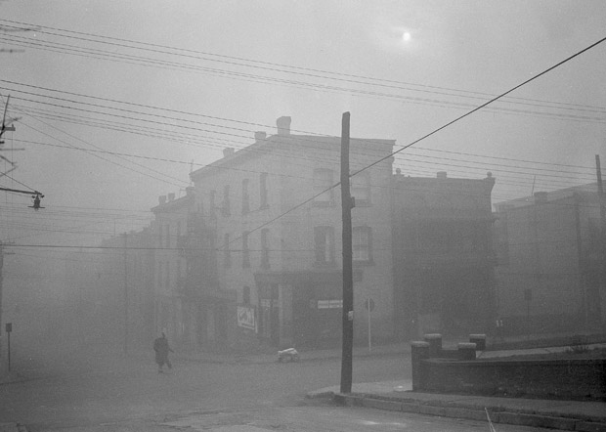
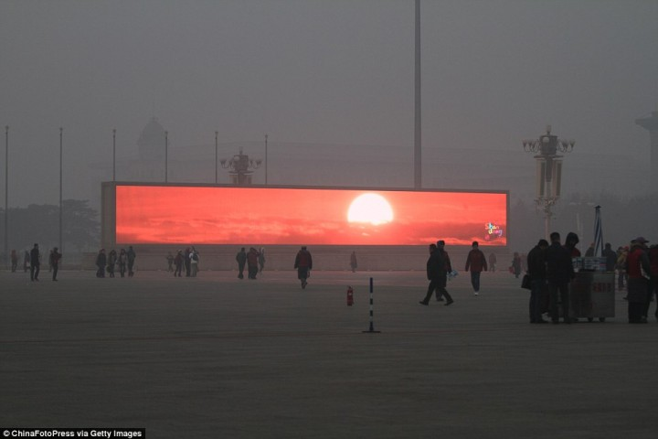
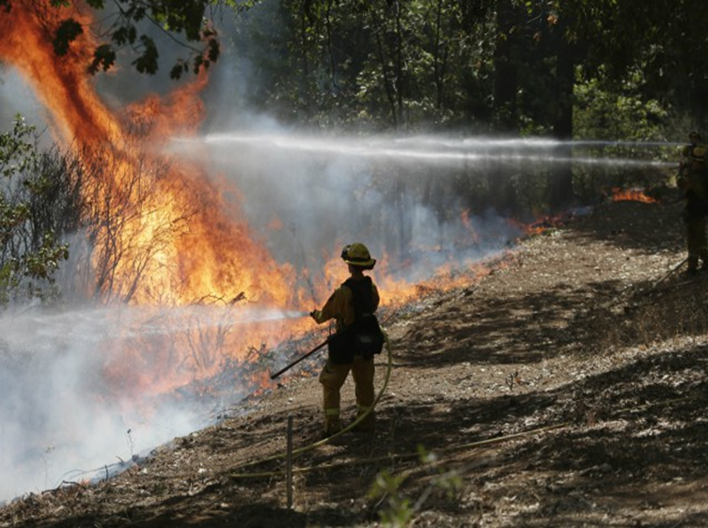
Smog
Denora, PA
Beijing, China
Wildfires

Slide 3
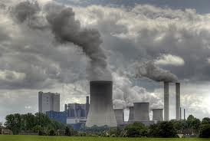
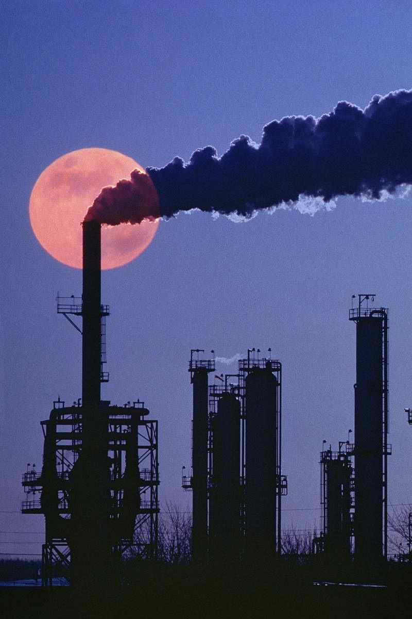
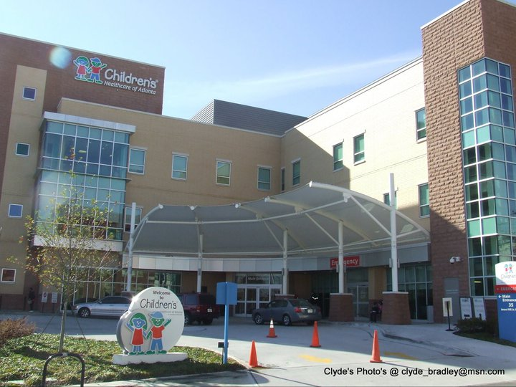
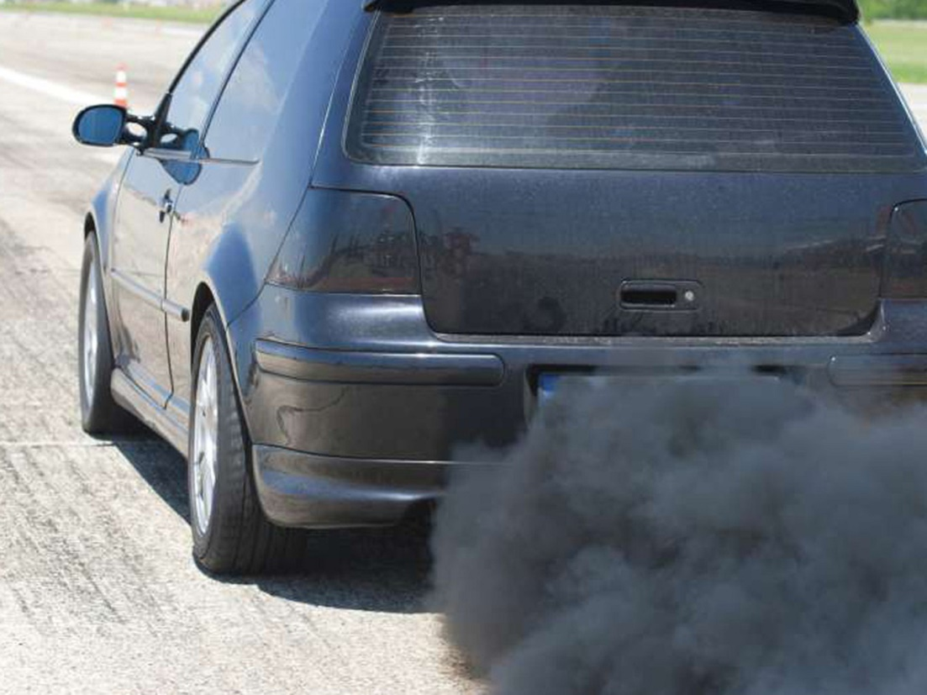
Coal plants
Plants/ factories
Commercial buildings
Fracking
Automobiles
Notes:
Sources of air pollution

Slide 4
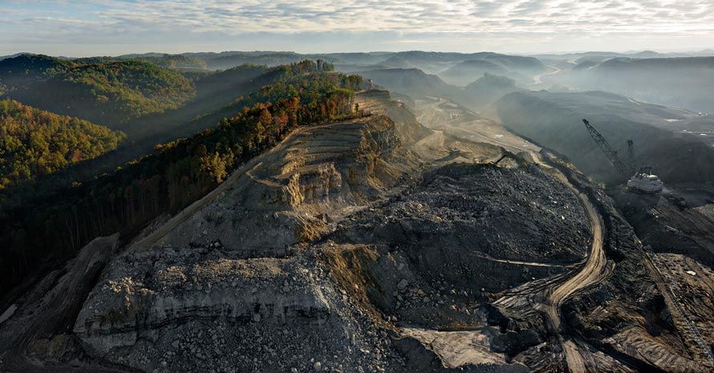
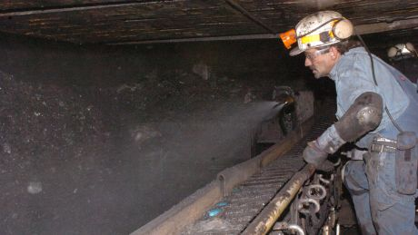
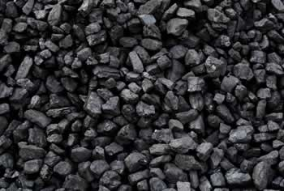
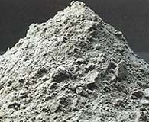
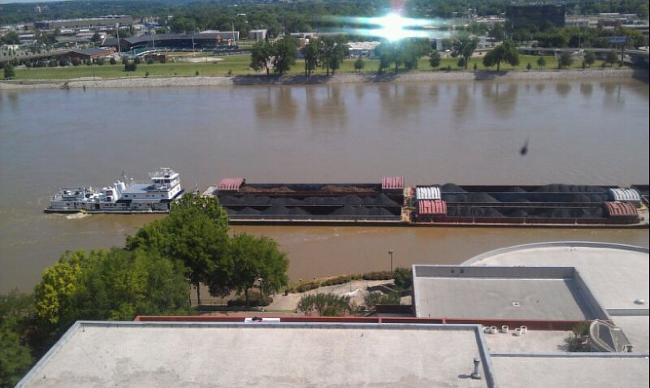
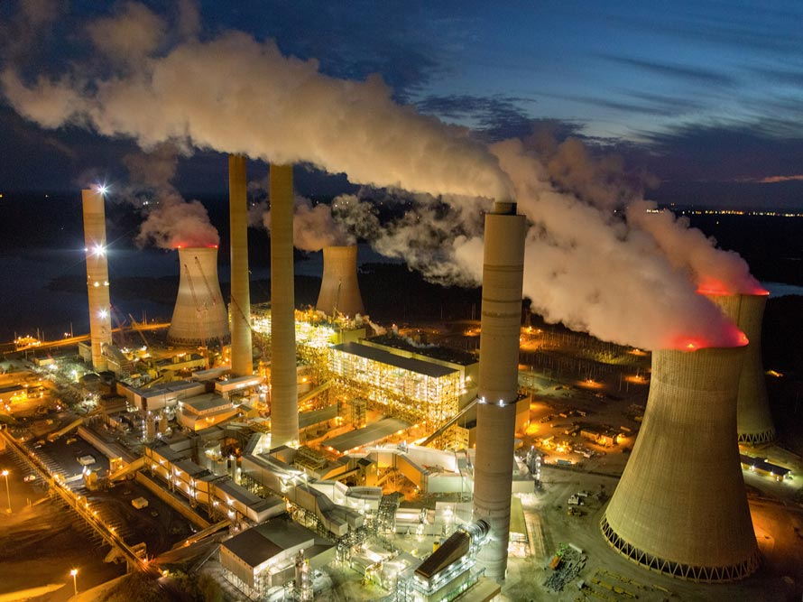
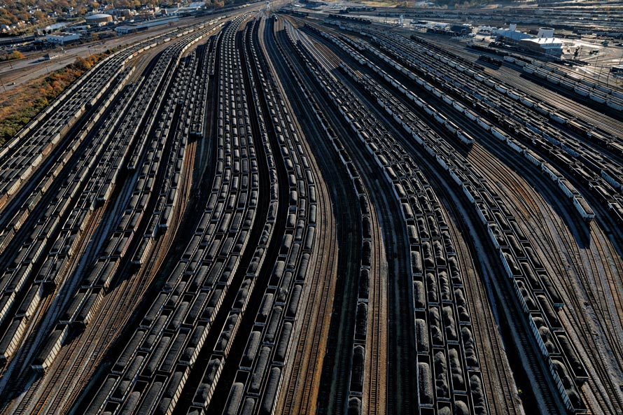
Coal
Mountaintop removal
Mining
Plants/ factories
Coal ash
Fracking
Electricity
Transport
Power station
Automobiles
Notes:
Coal life cycle

Slide 5
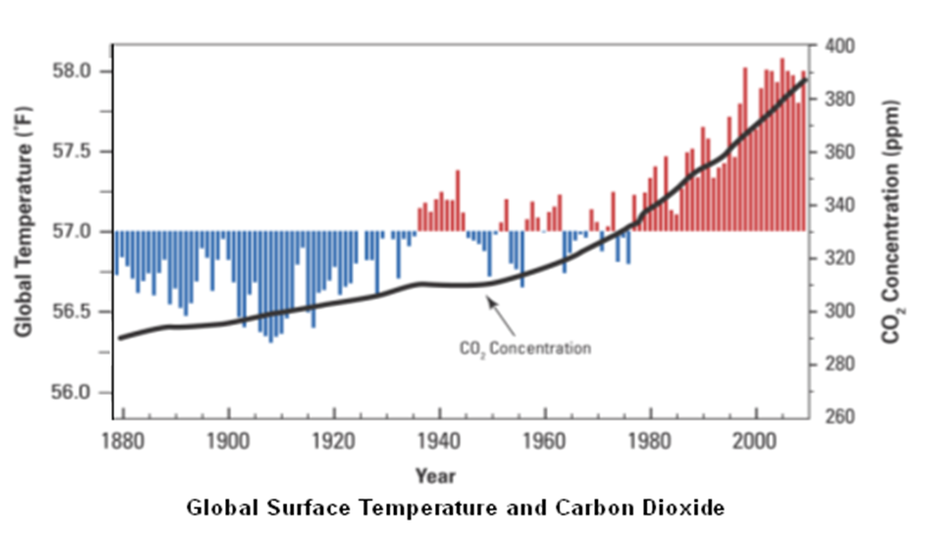
COEXISTING POLLUTANTS
VOCs-NO_{x}, SO₂
Ozone
PM
Elemental carbon
Heavy metals- lead, mercury, arsenic
Other hazardous air pollutants
GREENHOUSE GASES
CO₂- carbon dioxide: current level 400ppm, global temp increased 1.4F since 1880
CH₄-methane: 25x more potent than CO2
N2O-Nitrous oxides: 300x more potent than CO2
Fluorinated gases: 10,000-20,000 x more potent than CO2 and longest lasting

Slide 6
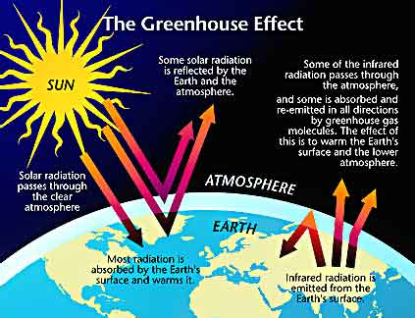
Notes:
Greenhouse gases trap heat and infrared radiation at the ground level. Unstable temperature and humidity weather patterns influenced by trade winds, ocean currents and jet streams contribute to heat waves and severity of natural disasters like thunderstorms and hurricanes, wildfires, droughts and desertification

Slide 7
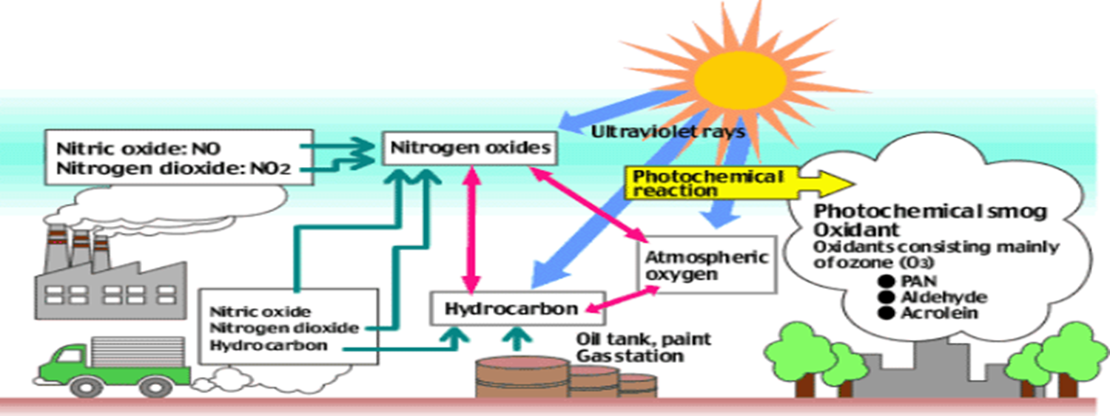
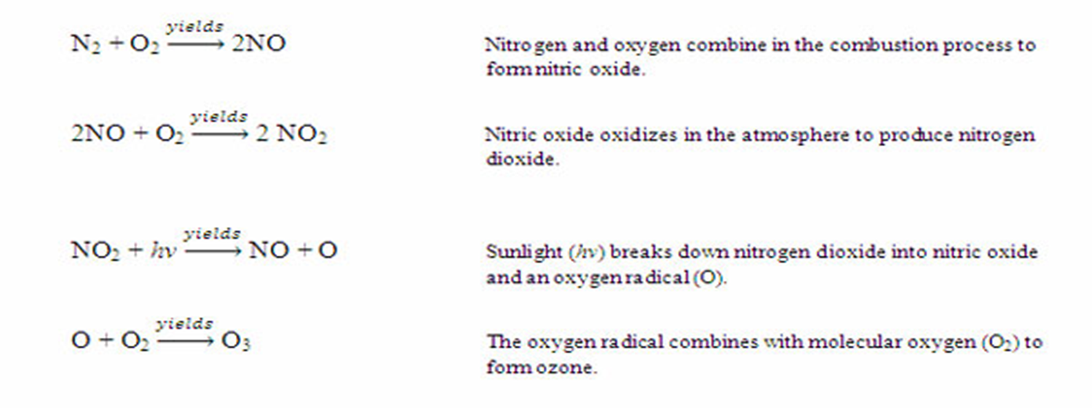
Ozone
TOXICOLOGY
Respiratory irritant- destroys ciliated airway cells & alveolar cells
Potent oxidant- generates free radicals
HEALTH IMPACTS
- Exacerbation/poor control of asthma, COPD and other lung diseases
- Reduced lung function
- Respiratory infection
- Birth complications
- Premature death

Slide 8
Ozone
STUDIES
Healthy adults had reduced FEV1 by 56 mL after days when ambient ozone ranged from 0.059 to 0.075 ppm compared to days with levels < 0.059 ppm
Rice et al. Short-term exposure to air pollution and lung function in the Framingham Heart Study. American Journal of Respiratory Critical Care Medicine 2013
Reduced FEF75 and FEF25-75 (small airway inflammation) seen in older adolescents chronically exposed to ambient ozone
Tager et al. Chronic Exposure to Ambient ozone and Lung Function in Young Adults. Epidemiology(16) 6. Nov 2005
Every 0.030 ppm increase in the 3-d avg of ozone was associated with an 8% higher risk of pneumonia and a 4% higher risk for URIs in children aged 0 to 4
Darrow et al. Air Pollution and Acute Respiratory Infections Among Children 0-4 Years of Age: An 18-Year Time-Series Study. American Journal of Epidemiology 2014
Lower birth weights, avg 47g, seen in babies exposed to a 12 ppb increase in 24h ozone, averaged over entire pregnancy
Salam et al. Birth Outcomes and Prenatal Exposure to Ozone, CO and PM: Results from the Children’s Health Study. Environmental Health Perspectives (113) 11. Nov 2005

Slide 9
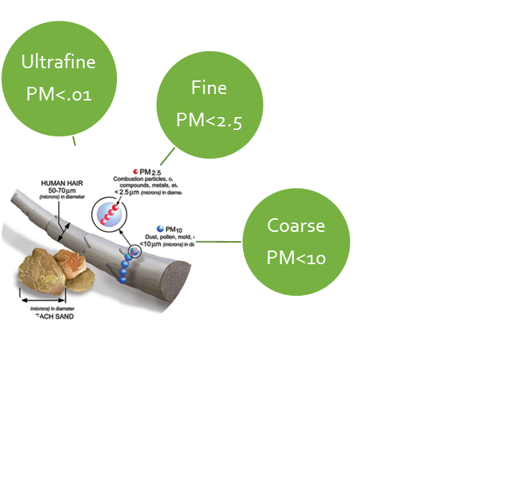
PARTICULATE MATTER
TOXICOLOGY
Bypass nasal cilia filtration
Direct access & deep penetration into lungs and
cardiovascular system
Pro-inflammatory, oxidative, mutagenic
HEALTH IMPACTS
-Exacerbation of asthma, COPD and other lung diseases
-Exacerbation of stroke, heart disease and other cardiovascular conditions
-Birth outcomes
-Systemic inflammation
STUDIES
Each increase of 10mcg/m³ of fine PM 2.5 is associated with birth weight decline of
18.4g in 1st trimester
10.5g in 2nd trimester
29.7g in 3rd trimester and
48.4g for total pregnancy

Slide 10
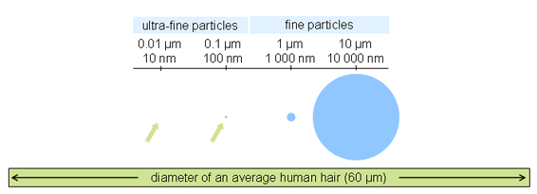
PARTICULATE MATTER
STUDIES
Particle inhalation causes endothelial activation and upregulation adhesion molecules important in leukocyte recruitment into atherosclerotic plaques
Eeden et al. Systemic Response to Ambient Particulate Matter. Proceedings of the American Thoracic Society (2). 2005
Each increase of 10 mcg/m³ PM 2.5 can increase risk of death from all causes by 3%, from heart disease by 10%, from respiratory disease by 27%
Hayes et al. Ambient Particulate Matter Air Pollution Exposure and Mortality in the NIH-AARP Diet and Health Cohort. Environmental Health Perspectives, Sept 2015
Each increase of 10mcg/m³ of PM 2.5 can increase lung cancer mortality by 15-27%
Turner et al. Long-term Ambient Fine PM Air Pollution and Lung Cancer in a Large Cohort of Never-Smokers
Each increase of 10mcg/m³ of PM 2.5, and also PM10, were associated with a decrease in FEV1 by 2.7ml, FVC by 3.5ml, and FVC growth by 1.5ml/y, in Chinese children
Roy et al. Ambient PM and Lung Function Growth in Chinese Children. Epidemiology 23(3) May 2012

Slide 11
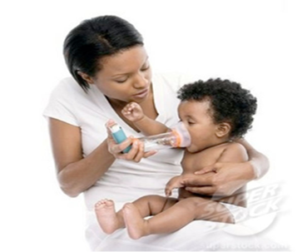
Special population: CHILDREN
>88% of climate change-related disease burden occurs in children <5y -WHO
Children exposed to ambient air pollution (PM, NO2) have decreasing lung function volumes (FEV1 and FEV1 growth rate)
Gauderman et al. Association between Air Pollution and Lung Function Growth in Southern California Children. American Journal of Respiratory & Critical Care Medicine (162) 2000
Risk factors
Faster breathing rate
Faster heart rate
Shorter height
Greater exposures per unit body weight-air pollutants
Smaller airway diameter
Lungs are only 80% developed at birth
More likely to experience respiratory arrest vs. cardiac arrest
More severe infections & higher complication rate
Unable to remove themselves from hazards
Difficulty taking medications
Dependent on caregivers, who may be impaired

Slide 12
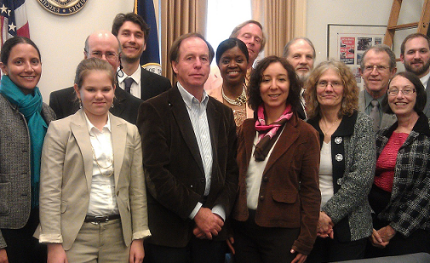
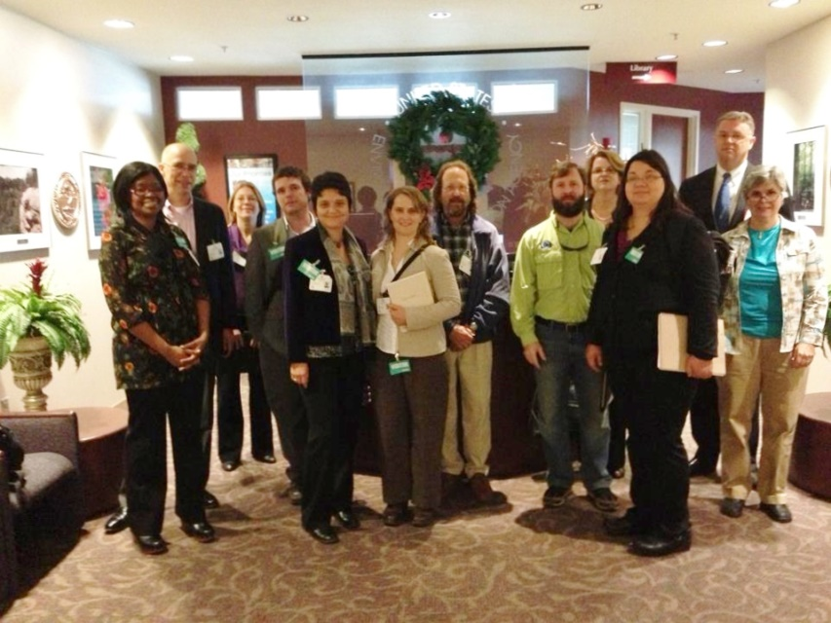
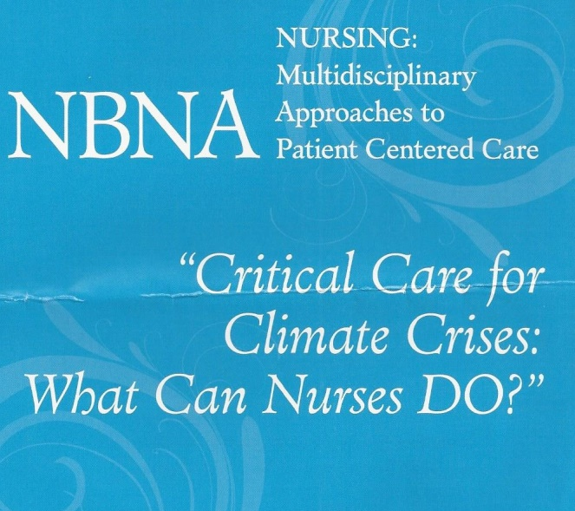
Coalition-building w/ NMA, PSR, EcoAmerica, NRDC, SACE, EarthJustice, Sierra Club, Mothers & Others for Clean Air
White House, EPA, Congressional Coal Ash Fly-in
GA EPD Coal Ash Hearing
GA State Legislators
Region 4 EPA Coal Ash Briefing
Press Conference w/ EPA, CDC, etc.
Climate Action Campaign, Essence Festival Luncheon
NBNA Luncheon
NMA Conferences
Notes:
Advocacy work

Slide 13
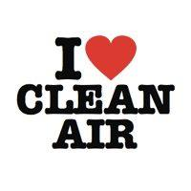
Thank You!

