Slide 1
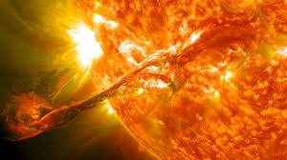

Extreme Heat:
The Health Effects of Climate Change
Mona Sarfaty, MD MPH FAAFP
Program Director

Slide 2
DECLARATIONS
I Have No Commercial Interests
to Declare Related to this Presentation
Presentation is partially supported by the
George Mason University Foundation

Slide 3
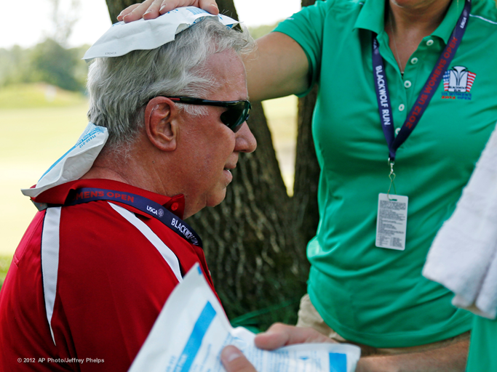
Significance of Heat
The Leading Cause of Mortality from Extreme Weather

Slide 5
Outline
How is the temperature changing in the U.S.?
What is an extreme heat event?
Who is vulnerable to heat events?
What kinds of problems do heat events cause?
What can we do about them?

Slide 6
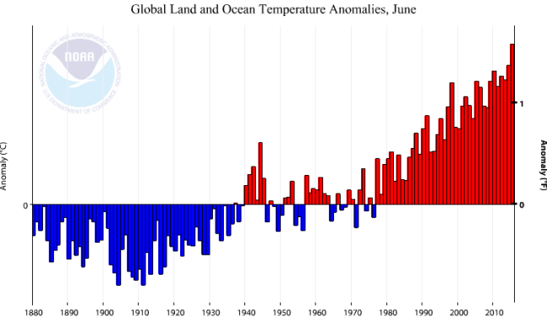
Global Cold and Heat Anomalies (1880-2015)
The NOAA global climate record for land and ocean temperatures over the last 136 years in which June of 2015 is now the all-time hottest. Image source: NOAA

Slide 7
Heat in the U.S.?
The August 2015 average temperature for contiguous U.S. was above average….
The August 2015 maximum temperature for contiguous U.S was above average….
The August 2015 minimum (nighttime) temperature for contiguous U.S was above average….(minimum’s matter, especially when it comes to tick reproduction)
BUT what about people’s individual experience where they live? (next slide)
Please note that while many areas were warmer than average, some were also colder than average. Some people may not have a direct experience of these changes. This is why the world average is such an important number. This has risen by only 1.3 degrees F and already produced dramatic effects.
*http://www.ncdc.noaa.gov/sotc/national/201508

Slide 8
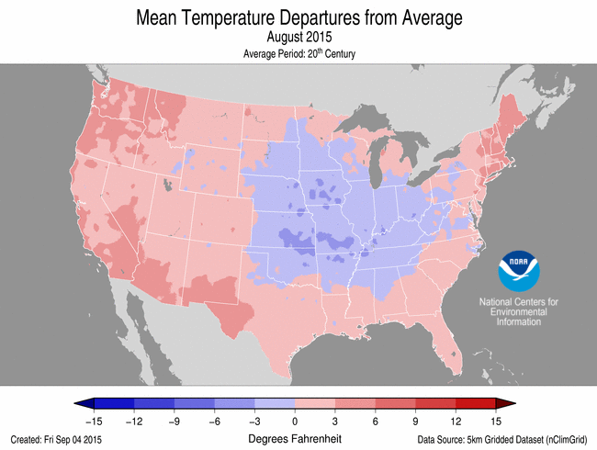

Slide 9
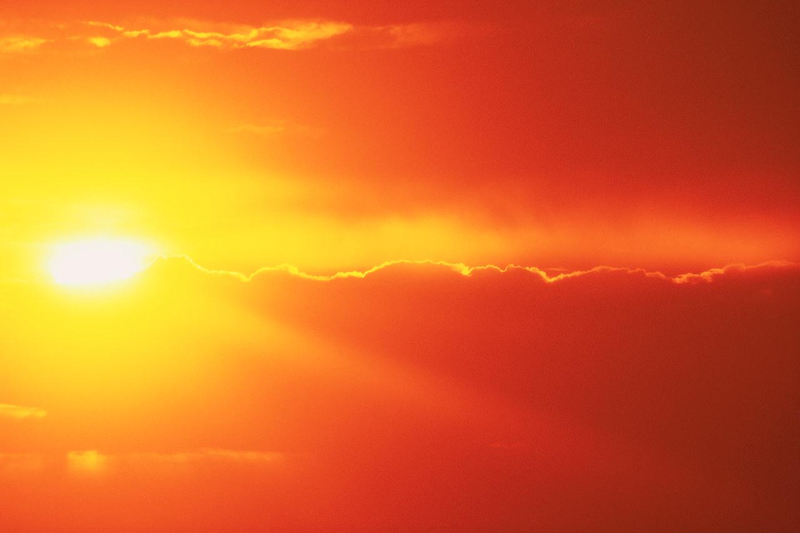
Extreme Heat
What are Extreme Heat Events:
Extreme heat events are characterized by weather that is substantially hotter and/or more humid for a particular location at a particular time.
Why hotter AND/OR more humid
Occur in all terrains (rural, surburban, urban).*
*Hayhoe K, et al., PNAS 2004.
Notes:
An extreme heat event is characterized by weather that is substantially hotter and/or more humid for a particular location at a particular time.
The definition of extreme heat event varies from place to place and it incorporates variables of temperature, humidity (or dew point), cloud cover, location, and how acclimated the population is to heat.
Sources:
(Anderson & Bell, 2011; NWS, 2009)

Slide 10
Who is Vulnerable to Heat Injury
Risk group
  Age: very old and very young
  Chronic diseases (heart, pulmonary, renal, mental health)
  Impaired mobility
  Lack of air conditioning
  People on certain medications
  Homeless
  People engaged in outdoor activities

Slide 11
CDC Mortality and Morbidity Reports (MMWR)
Nationwide review of heat deaths*
  ‘99-2009 total 7,233
  94% occurred during the warmer months of the year
Summary of deaths during heat wave 4 States 2012 **
  72% male; 75% living alone*
  Underlying cardiac/respiratory disease
  69% at home; 91% no air conditioning
  *Office of Climate, Water, and Weather Services. Weather fatalities, 2012. Silver Spring, MD: US Dept of Commerce, National Weather Service; 2013. http://www.nws.noaa.gov/om/hazstats.shtml
  **MMWR June 7, 2013; 62(22):433-436. (W.Va, Va, Ohio, MD 2012)

Slide 12
New York City, 2000-2011* (MMWR)
Analysis of data hospitals, death certificates, medical examiner records
  447 patients each year were treated for heat illness……. and released from EDs
  152 per year were hospitalized; 13 died from heat stroke
  Comorbidities were chronic diseases, mental health disorders, obesity
  *Wheeler K, Lane K, Walters S, Matte T. Heat Illness and Deaths New York City 2000-2011. MMWR. August 9, 2013; 62(31):617-621.

Slide 13
Health Professionals Know Why Some are at Increased Risk
Groups at increased risk:
    Elderly
      sweat less, less thirst drive
    Non-ambulatory
      May not seek cooler locations or hydrate
    Cardiopulmonary and renal conditions
      Circulatory burden and dehydration
    Mental health medications
      Thermoregulation
    Children (0-4) and older kids – thermoregulatory issues and activities
    Sports Enthusiasts – may overdo
    Laborers – may be placed at greater risk
    Homeless – may not recognize the danger or have resources to cope

Slide 14
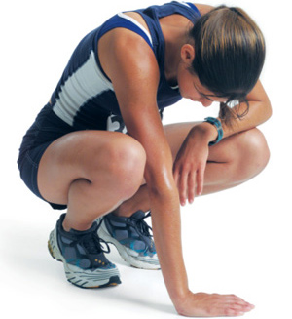
What does extreme heat mean for personal health?
Mild Symptoms (rash, heat fatigue)
Heat Exhaustion
  Thirst, rapid heart beat
  Weak/Dizzy
  Cramps/Headache
  Nausea/Vomiting
  Profuse Sweating
Heat Stroke:
  Confusion, Fainting, Coma
  Skin dry or moist
  Core (rectal) temp>104⁰
Risk of Mortality
*http://www.cdc.gov/extremeheat/warning.html
Notes:
The human body operates best within a narrow range of core body temperature, around 98.6 °F. When core body temperature rises, the body uses two main physiological mechanisms to cool itself: sweating and increasing blood circulation close to the skin’s surface.
If exposure to heat exceeds the body’s cooling capabilities, a range of heat-related symptoms and conditions can develop. Some of these things are relatively minor and easily treated, such as heat cramps or heat rash. Others are much more serious, including heat exhaustion (profuse sweating, weakness, rapid breathing, dizziness, nausea, muscle cramps, and headaches). If left untreated, heat exhaustion can lead to heat stroke which is a life-threatening medical emergency, usually occurring when the core body temperature exceeds 104 °F. High core body temperature can damage vital organs such as the brain, liver, and kidneys. This can result in serious illness, neurological damage, and death.
Heat Illness Definitions:
Heat tetany: These are symptoms of hyperventilation, other respiratory problems and muscular problems like spasms and numbness of muscles that result from short period of intense heat.
Heat rash: These are symptoms of skin irritation resulting from excessive sweating as a result of exposure to extreme heat.
Heat cramps: These are symptoms of excessive muscle spasms that occur with strenuous exercise during periods of extreme wave event.
Heat edema: These are symptoms of swelling in the ankles, feet and hands that occur in persons who are not used to hot climate during heat wave event.
Heat syncope: These are symptoms of dizziness and fainting that occur during heat wave period.
Heat exhaustion: These are symptoms of profuse sweating, weakness, rapid breathing, dizziness, nausea, muscle cramps and headaches that occur during heat wave period.
Heat/sun stroke: This life threatening and usually occurs when the body temperature is greater than 104˚F.
(picture: http://www.modernmedicalguide.com/heatstroke-or-sunstroke/)

Slide 15
What You Should Do about Heat Illness
If mild, hydrate and get out from heat
If more severe (heat exhaustion), hydrate, cool, move to a cooler location
If heat stroke, seek emergency care

Slide 16
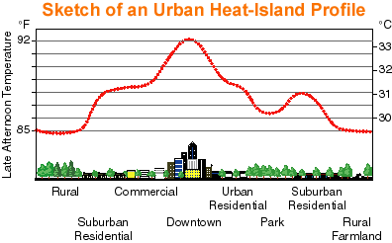
Less cooling green spaces, less air flow due to large buildings, and more heat absorbing surfaces can make cities hotter.
Notes:
Each city's urban heat island varies based on the city structure and thus the range of temperatures within the island “bubble” vary as well.
Parks and greenbelts reduce temperatures while the Central Business Districts- urban core, commercial areas, and dense housing tracts are areas of warmer temperatures.
Every house, building, and road changes the microclimate around it, contributing to the urban heat islands of our cities.
“Increased temperatures increases the demands for cooling > air-conditioning use, resulting in risks of power outages due to peak
Electricity demands, worsens air quality by promoting ground-level ozone formation and impairs water quality by heating storm water runoff, causing thermal shock for aquatic ecosystems.

Slide 17
Preventing Heat Injury and Mortality
Adequately protecting people requires clinical AND public health efforts
Communication is key
Clinical teams can reach their vulnerable patients
  Call elders who live alone, caretakers of the non-ambulatory
  Post relevant information or provide handouts during warm months
Public Health teams can reach the vulnerable
Government has a role also- coordination/communication

Slide 18

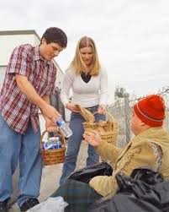
Preventing Mortality, continued
Risk Communication (at the right time)
  At Clinical Sites: identify and warn those at risk;
  call elders who live alone or caretakers.
  Posters, mail, hand out information (next slide)
  By Mass media (radio, television)
    Heat Alerts
Public Health/Local Government Resources
  Cooling centers
  Outreach teams
  Neighborhood: buddy systems, block captains

Slide 19
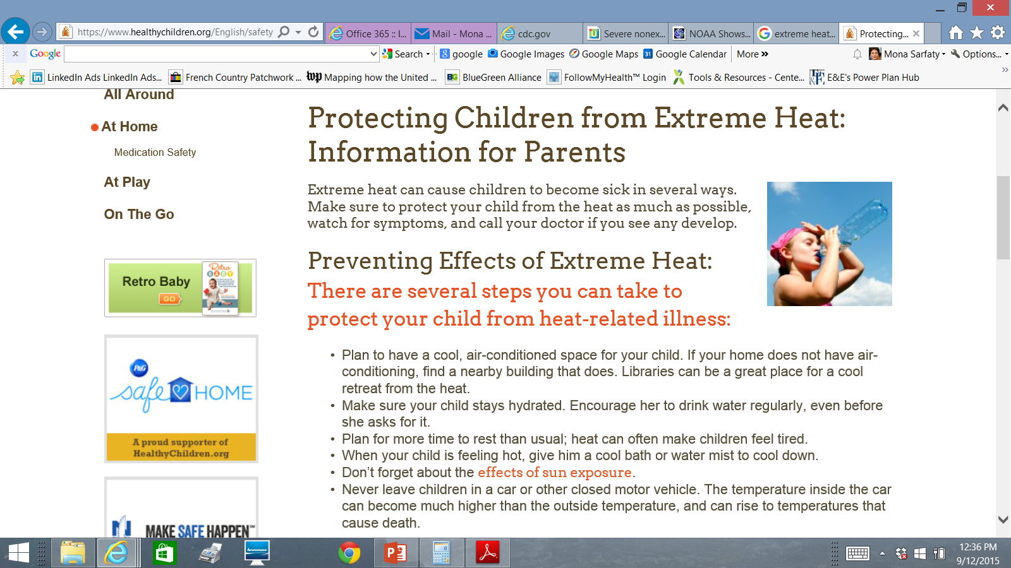

Slide 20
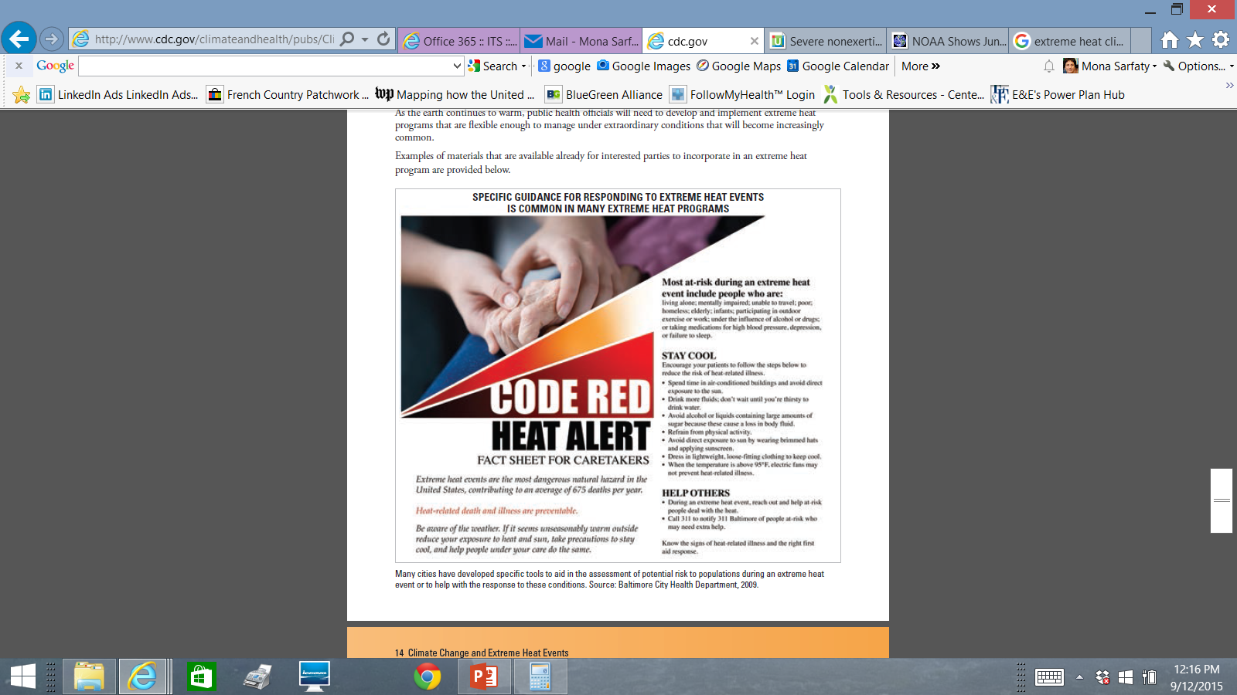

Slide 21
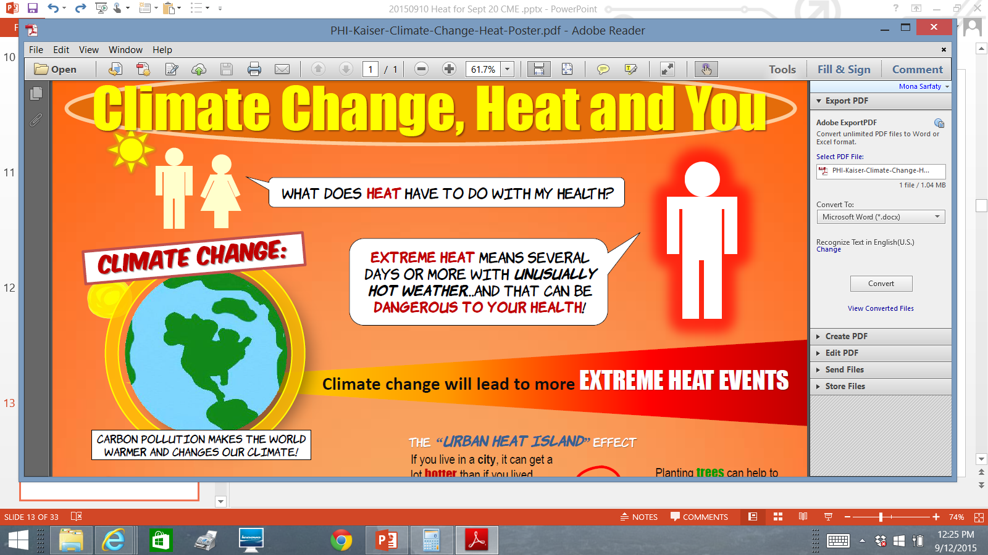

Slide 22

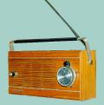
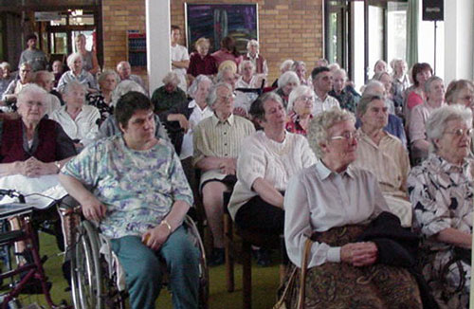
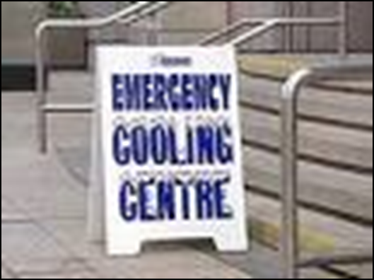
Adaptation is Saving Lives
Notes:
The 1993 event underscored the need to recognize risk factors for and institute strategies to prevent heat-related mortality.
In 1993 the City of Philadelphia began taking steps to reduce the public health threat from excessive heat.
The cornerstone of the city's response plan is its Heat Health Watch-Warning System (HHWWS).
Under the HHWWS, city staff work with the National Weather Service to determine when a heat wave is imminent.Once a heat alert is issued, the Philadelphia Health Department contacts news organizations with tips on how vulnerable individuals can protect themselves.
People who do not have air conditioning are advised to seek relief from the heat in urban shopping malls, senior centers, churches, libraries, and other air-conditioned spaces.
In addition, the city's 6,300 "block captains" are notified and asked to check on elderly neighbors. Block captains are individuals appointed by the city to assist vulnerable residents in their neighborhood.
The Public Health Department also takes the lead on activating a number of special summer heat responses, including:
•Home-visits by field teams
•Activation of the Philadelphia Corporation for Aging's "Heatline”
•Enhanced daytime outreach for the homeless
•A "Buddy System"The Heatline initiative is a telephone-based service where nurses are standing by to assist callers that may be experiencing health problems. If callers are deemed at-risk, mobile units are dispatched to that individual's residence. The Buddy System is a city-sponsored outreach effort that encourages the public to visit older friends, relatives, and neighbors during excessive heat events.
Public Health Action on Climate Change:
Heat wave( and severe storm response) plans; focus on the most vulnerable

Slide 23
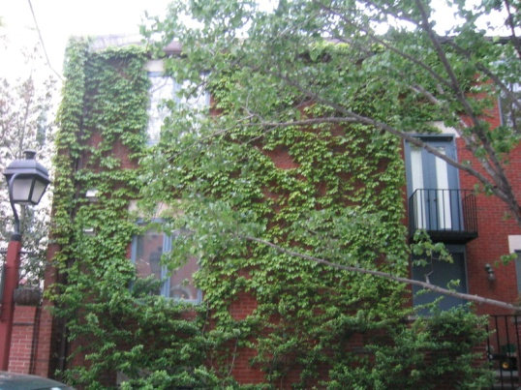

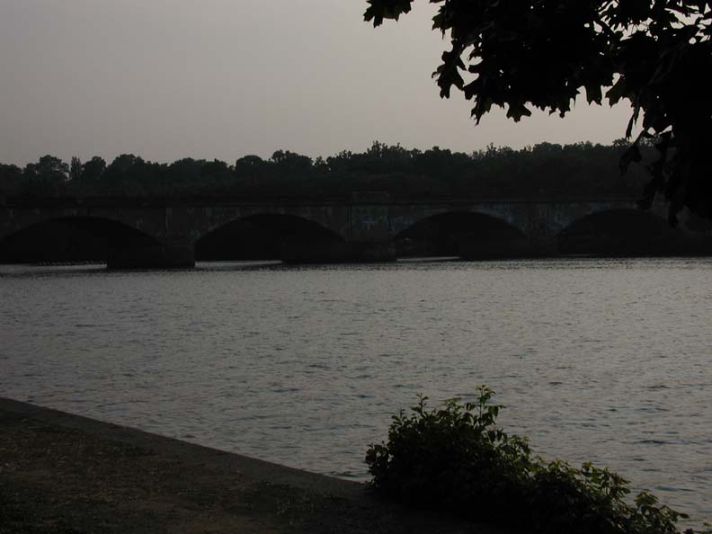

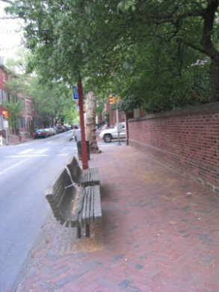
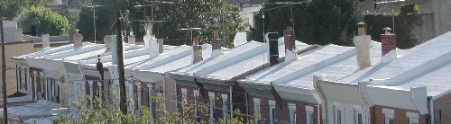
Community strategies to reduce heat risks
Cooler areas have vegetation and/or water
Notes:
What we know:
Temperatures are higher in more densely built up areas, and lower near parks, open green/pervious spaces, and tree clusters
Public Health Action on Climate Change:
Study and predict links between UHI, climate change and population health
Develop policies >>community planning, parity in access to “cool” outdoor spaces, etc…

Slide 24
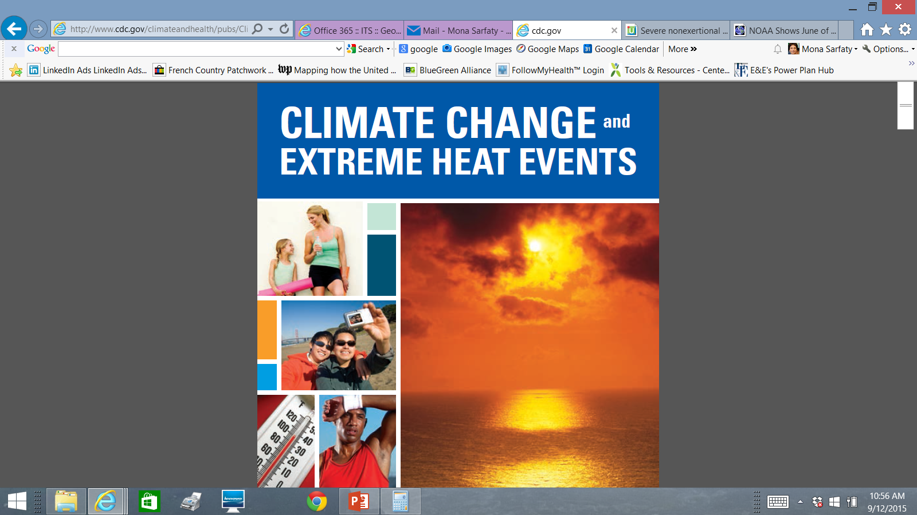
Resource (and Tool Kit)
http://www.cdc.gov/climateandhealth/pubs/ClimateChangeandExtremeHeatEvents.pdf

Slide 25

End of Heat Section
Thank You!
msarfaty@gmu.edu

