Slide 1
What a Changing Climate Means for Children’s Health Samantha Ahdoot, MD, FAAP Assistant Professor of Pediatrics Virginia Commonwealth University School of Medicine AAP Council on Environmental Health, Executive Committee Lead Author, Global Climate Change and Child Health, Pediatrics, 2015 Board of Directors, Virginia Chapter AAP
Notes:
Today I will talking to you all about what Climate Change means for our patients and for us, their pediatricians.
I’ve entitled my presentation:

Slide 2
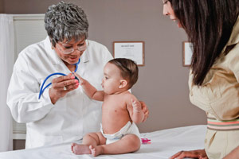
Roles of Pediatricians
\\]
Diagnosis and treatment
Medical decision maker
Patient advocate
Anticipatory guidance
Community advisor
Practice manager
Source: NIEHS
Notes:
So what does this mean for kids? And what does it mean for us, as pediatricians? In today’s talk, I will be discussing how climate changes affects the health of our patients, and our roles as pediatricians in many capacities; as clinicians, as advocates, as advisor, and as practice managers.

Slide 3
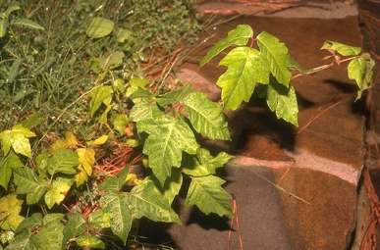
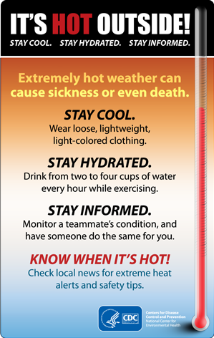
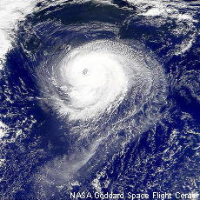
Child Health in a Changing Climate
Child Health
Shifts in range and life cycles
Plant Allergens
Rising Temperature
Extreme
Weather
Notes:
The changing climate presents numerous risks to child health. Some climate associated health effects are being felt today, while it’s projected that they will become more apparent as the planet continues to warm.
Changes in our climate influence the geographic range, seasonal timing of some infectious diseases,
Warmer temperatures, as well as increasing concentration of CO2 in the atmosphere, results in changes in the growth and allergenicity of some plants that cause allergic disease.
Rising temperatures and hotter summers are putting more children at risk of heat illness.
And extreme weather events, such as floods and hurricanes, can all affect children directly, through injury or death, or indirectly, through harm to their caregivers and their communities and to local infrastructure and health care delivery systems.

Slide 4
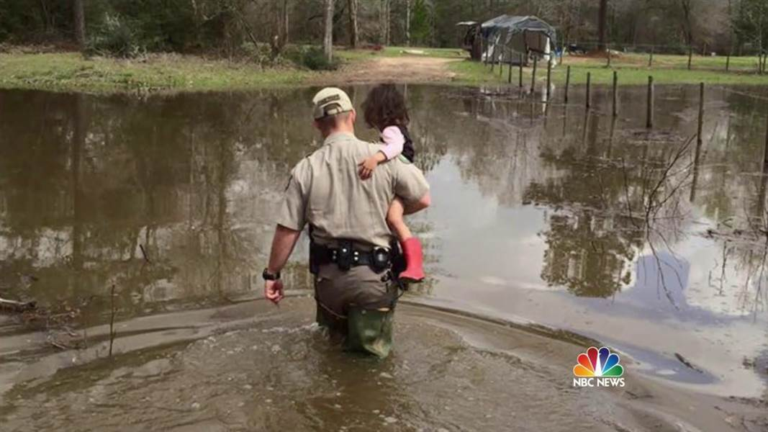
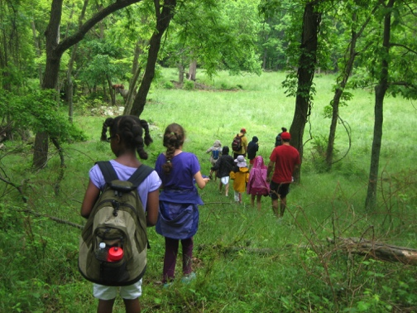
Children are More Vulnerable
Unique characteristics:
↑ minute ventilation
↑ food & water per weight
physiologic/cognitive immaturity
windows of vulnerability
↑ interaction with outdoors
5000 children were separated from their parents by Hurricane Katrina.
Source: The National Center for Missing & Exploited Children/AP
Swollen Rivers, Historic Flooding across the South
NEWS MAR 15 2016, 6:06 PM ET
Source: NBCnews.com
Notes:
Children are a high risk group to the health impacts of climate change.
Higher minute ventilation, exposing them to higher doses of air pollutants, such as ozone, which increases with higher temperatures.
They eat and drink 3 times more per unit body weight than adults, placing them at higher risk to toxins and contaminants, as well as to food and water scarcity
They are immature, both physically and mentally. This means they may be unable to recognize or respond to threats appropriately. Rather, they’re dependent on caregivers for their health and safety.
Children also depend on stable community resources such as schools and vaccination programs, for healthy growth and development.
Children have windows of vulnerability, during which insults can result in permanent disability. For example, undernutrition at a young ages can cause permanent stunting of growth, which can also affect the health of that child’s future children.
Lastly, children have greater interaction with the outdoor environment, which increases their exposure to toxins, heat, and insects.

Slide 5
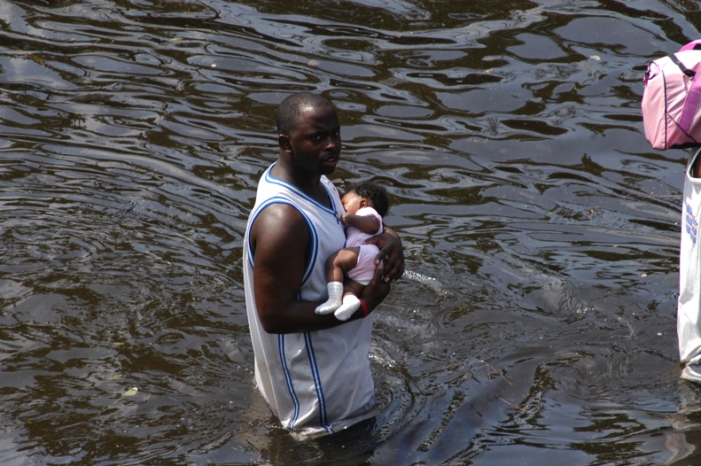
Climate Change Affects Every Child
Estimated > 88% of the global burden of disease due to climate change occurs in children under the age of 5. ( Zhang, J Environ Health 2007)
Children in low resource countries at highest risk.
In the U.S., children are already
experiencing:
1. Increased severe heat events.
2. Changes in pollen allergy season.
3. Altered infectious disease patterns.
4. Worsening severe weather events. New Orleans, La. (Aug 31, 2005) A man carries a baby through the flooded streets of New Orleans. U.S. Navy photo (RELEASED)
Notes:
For these reasons, children bear the majority of climate related health impacts. It’s estimated that > 88% of the global burden of disease due to climate change occurs in children under the age of 5.
Children in low resource countries are at highest risk, and are vulnerable to major impacts including malnutrition, diarrheal illness and displacement.
Although children in the U.S. are currently insulated from some of these severe impacts, they are not immune. Children in the U.S. today are already experiencing:
Increased severe heat events
Changes in the the pollen allergy season
Altered infectious disease patterns, and
Increased in some severe weather events.
I will now discuss some of these effects in more depth, highlighting individual cases, some of which are from my own practice in Virginia.

Slide 6
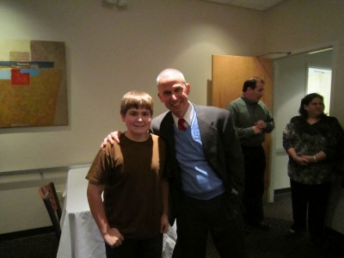
Logan’s Story
August, 2010
Source: ksi.uconn.edu
Practiced basketball in Arkansas gym without air conditioning.
Developed unrecognized heat stroke, followed by rhabdomyolysis, kidney failure and pulmonary edema.
Treated successfully in PICU with dialysis.
Notes:
I’d like to start with Logan Story. This story comes from the Korey Stringer Institute, which is a non-profit organization dedicated to preventing sudden death in sports, and was founded in honor of Korey Stringer, a professional football player who died from exertional heat stroke in 2001.
In August 2010, Logan was practicing basketball in an un-air conditioned gym in Arkansas during a record-setting hot summer, with a heat index of over 110 for several consecutive days.
During practice he developed weakness and fatigue, but his illness was not recognized. He went on to develop to heat stroke and rhabdomyolysis, followed by kidney failure and pulmonary edema. He was treated successfully in the PICU with dialysis and thankfully recovered completely.

Slide 7
Exertional Heat Illness (EHI) In High School Athletes
>9,000 illnesses/year in high school athletes
(MMWR 2010)
> 1/3 U.S. ED visits for EHI are in teenage male athletes
(MMWR 2011)
EHI rate in football players 11.4 x that in all other sports combined. (Kerr et al, Am J Prev Med, 2013)
2003-2013, high school/college football deaths from heat injury doubled relative to 1990’s (Gottschalk, Sports Med Arthr Rev, 2011)
Notes:
Extreme heat events are increasing.
While the elderly are at greatest risk from heat illness, children, particularly student athletes and young infants, are also at elevated risk.
Heat illness is a leading cause of death and disability in high school athletes, with > 9,000 illnesses per year.
1/3 of ER visits for exertional heat injury occur in teenage male athletes, with football players at greatest risk.
Rate of exertional heat illness in football players is over 11 times greater than in all other sports combined.
Sports related heat illness occurs most frequently in August, when most schools begin preseason sports training.
While absolute numbers are low, American high school and college football deaths due to heat injury may be increasing. Their number doubled in the decade 2003-2013 relative to the 1990s
(Am. Football deaths due to heat stroke: 1990’s: 15. 2000-2010: 29. 1993-2003:21, 2003-2013: 31)

Slide 8
Rising EHI ED Visits 1997-2006
•Rates per 100,000 population treated in U.S. EDs 97–2006. 54,983 patients.
•Increased significantly by 133.5%.
•Almost half of patients children or adolescents.
(Nelson et al, Am J Prev Med, 2011)
Notes:
This graph depicts ED visits for exertional heat injury btw 1997-2006.
The dark solid line is males, the dashed is male and females, the bottom is females.
Between 1997-2006, Emergency Department visits for heat related illness increased significantly by 133.5%. The rate per 100,000 population more than doubled.
There was a large sample, of almost 55,000 patients.
Almost half of these patients were children and adolescents and almost ¾ were male. Football was the highest risk activity.

Slide 9
Heat Illness in Children
Source: Freeimages.com
Immature thermoregulation, higher metabolic rate, dependence on caregivers.
Children at risk of dehydration, electrolyte imbalance, renal disease, heat illness. (Kovats et al, Occup Environ Med, 2004; Nitschke et al, Environ Health, 2011;Xu et al, J Epidemiol Community Health, 2014)
Infants are uniquely vulnerable group to heat-related mortality.
(Basagna, Epidemiology 2011; Basu, Am J Epidemiol 2008; Xu et al, Environ Res, 2012)
Infants suffer second-highest heat mortality rate among all groups. (Deschenes and Greenstone, American Economic Journal: Applied Economics, 2011)
.
Notes:
Children’s immature thermoregulation, higher metabolic rate, and dependence on caregivers places them at risk of ER visits and hospitalization during extreme heat events.
Pediatric diagnoses during these events include dehydration, electrolyte imbalance, renal disease and heat illness.
Infants < 1 appear to be a particularly high risk group to heat-related mortality
They suffer the second-highest rate of heat-related deaths, after the elderly. And some studies project that they will experience the greatest increase in mortality rates due to rising global temperature.

Slide 10
Sam and Sophia
•9 year old boy in Virginia •2 year old girl in Virginia.
•Spring 2016, treated with 3 medications. •Not responsive to antihistamine.
•Required treatment with ocular steroid. •Appearance of abuse
(permission for photo use granted by parents of both children)
Notes:
I’m now going to discuss the affects of climate change on seasonal allergies.
I’d like to tell the story of two children I saw in my practice this spring. I’ll call them Sam and Sophia. Both of their parents gave permission for me to tell their stories and use their photos.
Sam is a 9 year old boy with a history of seasonal allergies.
This spring, he was being treated with 3 medications, an oral antihistamine, a nasal steroid and an ocular antihistamine.
Despite this treatment, he came to me one afternoon in April, looking like this, with severe eye redness, watery drainage and a facial rash. He had been sent home from school because he couldn’t concentrate, and was just sitting at his desk rubbing his eyes. I had to place him on a steroid eye drop.
Sophia is a 2 year old I saw this spring. She was being treated with an oral histamine, but she continued to have significant dark circles under her eyes. These looked so bad, her mother brought her in because she was afraid that it looked like she was being abused. She responded to a nasal steroid.
For many physicians, allergies appear to have worsened. In a survey of 3 medical societies, including American Thoracic Society, American Academy of Allergy and Immunology and the National Medical Association, 63% of physicians indicated that climate change was causing their own patients to have more allergy symptoms and visits

Slide 11
Elevated CO₂ and Pollen Counts
1) Ragweed plants produce more pollen when grown in higher temperature and CO₂.
(Singer, Funct Plant Biol, 2005)
2) Plants grown in today’s CO₂ produced about twice as much pollen as in CO₂ of last century.
(Ziska , World Resource Rev, 2000)
3) Average U.S. pollen count increased by 42-46% in 2000’s relative to 1990’s.
(Zhang et al, Global Change Biology, 2015)
(Beggs PJ, Bambrick HJ. Environ Health Perspect, 2005)
Notes:
CC can affect seasonal allergies through several mechanisms. One is the direct effect of increasing Carbon Dioxide concentrations on plant pollen production.
Ragweed produces more pollen when grown in higher CO2 and temperature.
A study by Lewis Ziska from USDA in 2000 found that plants grown in approximate CO2 concentration of today (370) produced twice as much pollen as those grown in Co2 concentrations of last century (280)
The image on the right depicts the increase in ragweed pollen production for plants grown at different CO2 concentrations.
Blue line is from the 2000 study I mentioned, which found that raising the CO2 concentration from 280 to 370 ppm resulted in an increase in pollen production of 131%
Pink line-Depicts the further increase in pollen production for plants grown at 600 ppm CO2. These plants produced 320% more pollen than plants grown at 280 ppm.
The green line depicts a different study which showed that raising the CO2 concentration form 350 to 700 ppm increased ragweed pollen production by 61%.
Last year, study found that average U.S. pollen count has increased by 42-46% in the 2000’s relative to the 1990’s. Degree of increase was highly region specific, inconsistencies in methods of measurement in the different regions

Slide 12
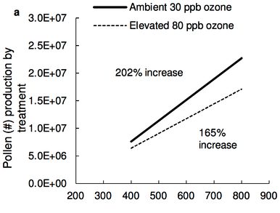
Predicted Increases in Grass Pollen
Timothy grass grown at 800 ppm CO2 concentration produced 200% more pollen than plants grown at 400 ppm.
Albertine JM, et al. (2014) PLoS ONE 9(11)
Notes:
Like ragweed, grass pollen production also has been shown to increase in response to elevated CO2.
This slide is from a study evaluating Timothy grass, a major cause of summer allergies throughout temperature zones.
The study found that grass grown at 800 ppm produced 200% more pollen than plants grown at 400 ppm.

Slide 13
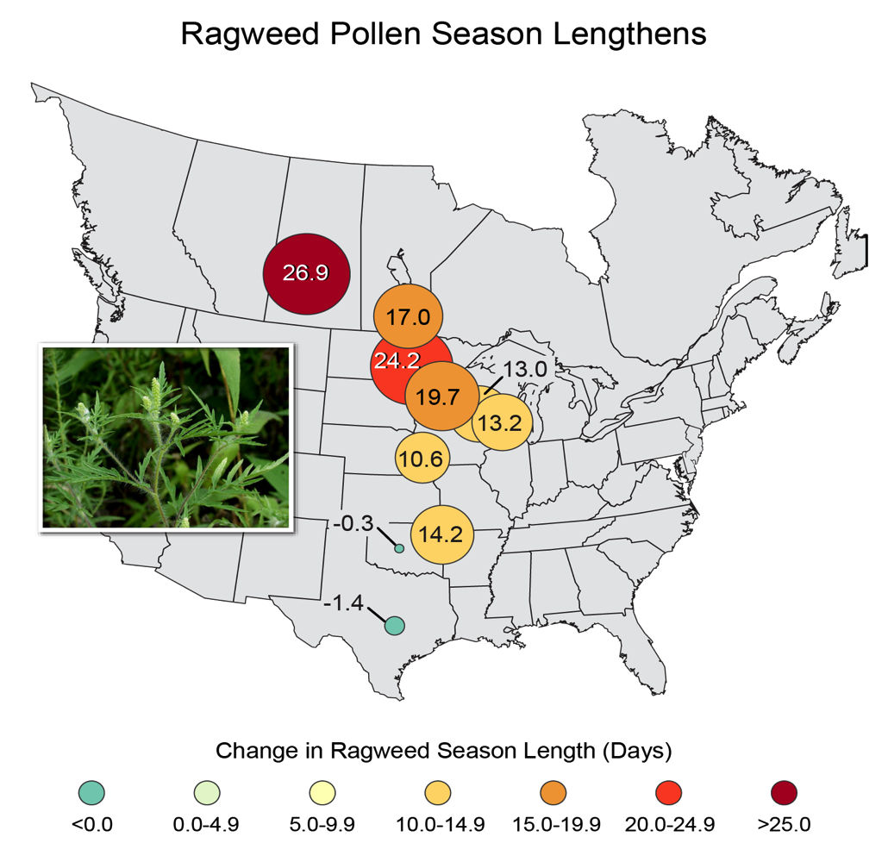
Longer Ragweed Pollen Season
1995-2013
http://nca2014.globalchange.gov/report/sectors/human-health#intro-section-2
Notes:
So higher CO2 causes ragweed and grass to make more pollen.
Higher temperatures are causing the allergy season to get longer.
Throughout North America, winter is coming later and spring is coming earlier. This means there has been an increase in the number of days without frost. This has been most significant in Northern latitudes.
These Northern regions have had a corresponding greater increase in the allergy season. For example, Southern Canada has experienced a 27 day increase in the allergy season. Mid latitudes of the country have experienced about a 10-15 day increase, while Texas and Oklahoma, which traditionally have little frost to begin with, have had virtually no change.

Slide 14
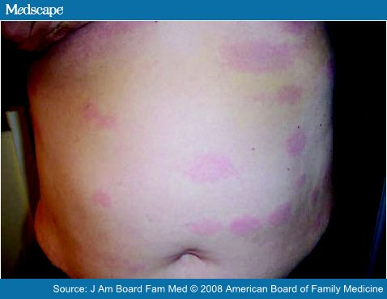
Robert’s Story
14 year old boy in Virginia.
Presented 9/2015 with rash.
Diagnosed with urticaria.
Returned 3/16 with swollen, painful knees.
Diagnosed with Lyme, treated with Doxycycline.
Developed pill esophagitis and severe sunburn.
Notes:
I’d now like to tell the story of a boy in my practice who I’ll call Robert.
Robert presented to my office last fall with a diffuse rash much like the one in this photo. He has diagnosed with urticaria and the rash resolved over the course of about one week.
In March of this year, he returned to my office with swelling and pain in both knees. He tested + for Lyme, and it was recognized that his rash back in September was not actually urticaria but had been disseminated erythema migrans. This is a frequently made misdiagnosis.
He was treated with a four week course of Doxycycline. Unfortunately, he developed pill esophagiits requiring treatment with a PPI, as well as a severe sunburn. This was concerning to his father, as his mother (Robert’s grandmother) had melanoma.

Slide 15
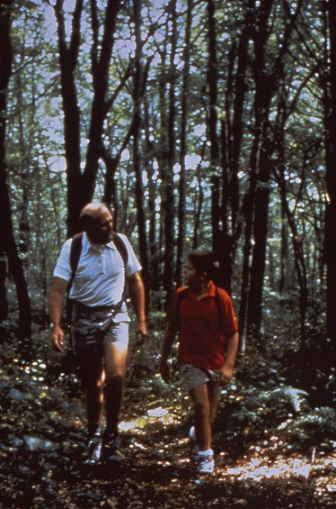
Lyme Disease Range Expansion
Boys 5-9 years at greatest risk.
Carried by Ixodes Scapularis tick.
Ixodes Scapularis has expanded its range Northward and brought Lyme Disease with it.
This has occurred coincident to, or after, rise in temperature in these regions, but not before.
(Ogden, Int J Health Geogr 2008; Ogden, Environ Health Perspect, 2014)
Source: phil.cdc.gov
Notes:
Lyme disease is most common in children, with boys ages 5-9 years old at greatest risk.
The bacteria, Borrelia Burgdorferi, is carried by the Ixodes Scapularis tick in the Northeast and northern midwest, and by the Ixodes Pacificus tick on the West Coast.
Infection can cause rash, arthritis, meningitis or, rarely, heart block.
Above or below threshold temperatures, basically when it’s hot or cold enough, ticks die off more than they reproduce, so populations can’t become established.
As temperatures have warmed, the range of Ixodes Scapularis has expanded Northward in North America, and has now established populations in Canada.
There are other factors that could have contributed to this, such as reforestation in the Northeastern US. However, this has not occurred in Canada, where there has been a net deforestation in affected regions.

Slide 16
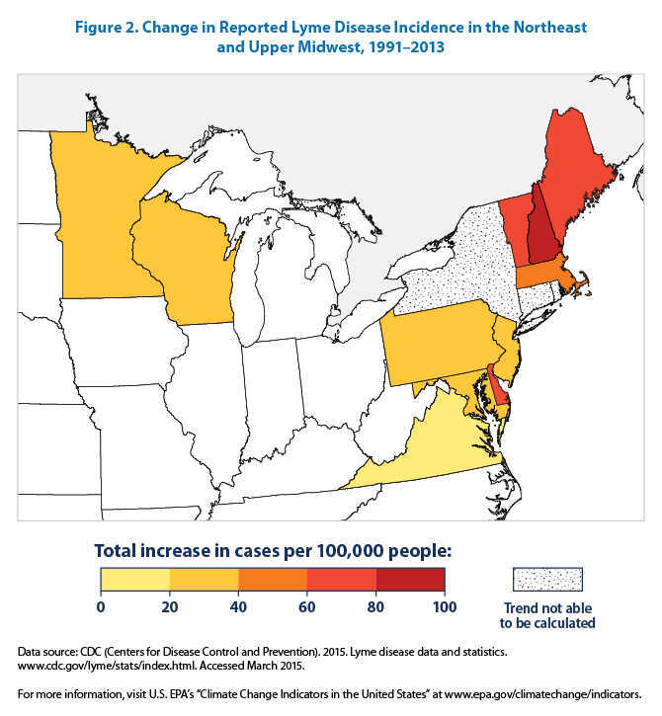
Lyme Disease in the U.S.
Among the states where Lyme disease is most common, New Hampshire and Vermont have experienced the largest increases in reported cases.
Notes:
In the U.S., Lyme disease increase has been predominantly in the Northeastern states. Among the states where Lyme is most common, New Hampshire and Vermont have experienced the largest increases in reported cases. The image on the left depicts change in reported cases between 1991-2013. You can see the greatest increases in New Hampshire, Maine and Vermont.
The image on the right depicts reported cases of Lyme between 1996-2013. You can see the dramatic increases in Northeastern states.

Slide 17
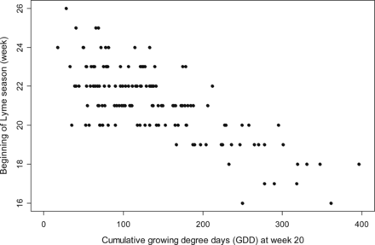
Warmer Winters Lead to Earlier Lyme Season
Beginning week of Lyme disease season across all states and years as a function of the cumulative growing degree days (GDD) above 10°C. Moore, SM et al. Am J Trop Med Hyg, 2014
Notes:
Rising temperature affects when the Lyme season begins as well.
Warmer temperatures trigger tick host- seeking behavior. This influences when the Lyme disease season begins.
This image is from a study that evaluated the relationship between the beginning of the Lyme disease season, on the Y axis, and the cumulative # of days above 10 degrees C (or 50 degrees F) at week 20 (May)on the x axis. This was based on data from 12 highly endemic states during the years 1992-2007.
This study found a clear relationship between more cumulative warm days in the first 5 months of the year and earlier onset of the Lyme season.

Slide 18
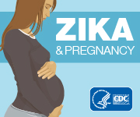
Some Like it Hot
Aedes Mosquitoes
Primary vectors for Dengue, Chikungunya and Zika.
Currently widest distribution ever recorded, extensive in all continents.
(Kramer M et al, eLife, 2015)
Climate change can:
expand vector range
extend the transmission season
shorten mosquito life cycle
reduce time to mosquito infectivity
(Sirisena P, Int Journal of Inf Dis, 2014)
Notes:
Ticks are not the only insects affected by higher temperatures. Mosquitoes, their distribution and populations, are also affected.
Aedes aegypti and Aedes albopictus mosquitoes are the primary vectors of several important infections, including Dengue Fever, Chikungunya and Zika Virus.
These mosquitoes are rapidly expanding their territory around the globe. Most has occurred over past 30 years.
Currently, these mosquitoes inhabit the widest distribution ever recorded, in all continents, including North America and Europe.
Many factors influence the range of these mosquitoes…
The influence of climate variables on these infections are complex and incompletely understood.
However, rising temperature is thought to be playing a role in the spread of these diseases.
Climate change can
1) expand vector range. Suitable habitat is usually determined by the minimum winter temperature in a given region.
2) Longer transmission season
3) Warmer temperatures can shorten the mosquito life cycle, so female mosquitos can lay eggs more frequently.
4) And higher temperatures can shorten the time between mosquito uptake of a virus to when it is able to transmit the virus.

Slide 19
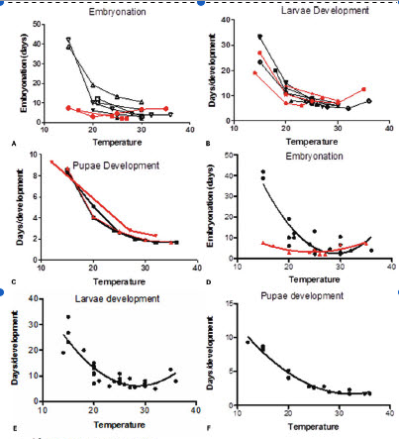
Some Like it Hot
Increased temperature speeds Aedes albopictus immature development
Waldock J, Pathogens and Global Health, 2013
Notes:
This image is from a study evaluating the effect of temperature on Aedes Albopictus immature development time, with the y axes representing # of days, and the x axis temperature.
Higher temperature, up to a certain threshold, results in decreased # of days required to complete mosquito immature development.
Above that threshold temperature, development rate stays the same or slows.

Slide 20
Expect the Unexpected
Notes:
There are also effects that are unexpected.
Unprecedented experiment as we change the composition of gases in our atmosphere to levels never encountered before by human civilization.

Slide 21
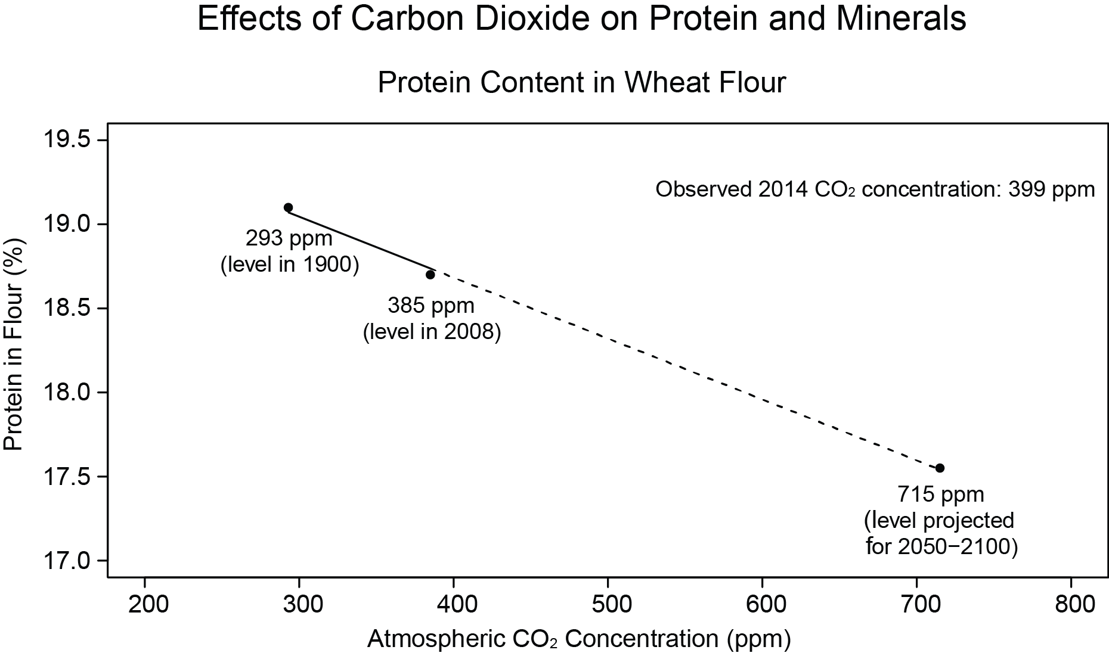
Rising CO₂ lowers Crop Protein
(Source: Health2016.globalchange.gov)
● Raising CO2 from 293 to 385 to 715 ppm progressively lowers wheat flour protein concentration.
(Taub, Global Change Biology 2008; Ziska et al, Global Change Biology, 2004)
● Total protein concentration > 11.5% required for adequate bread making.
(Hogy, Journal of Cereal Science, 2008)
Notes:
It’s known that Carbon Dioxide has a fertilizer effect on many plants, and can increase plant productivity.
However, it also can affect the composition of plant materials.
Multiple studies from across the globe have now shown that increasing the concentration of carbon dioxide in the atmosphere decreases the concentration of protein in many plants, including some of the world’s most significant crops, including wheat, rice and soybean. Corn is not affected in this way.
This image includes experimental data from 2 studies. These found that raising the CO2 from t 293 to 385 to 715 ppm progressively lowers the protein concentration in wheat.
I think it’s valuable to note that you need a minimum amount of protein of about 11.5 %to make good bread.

Slide 22
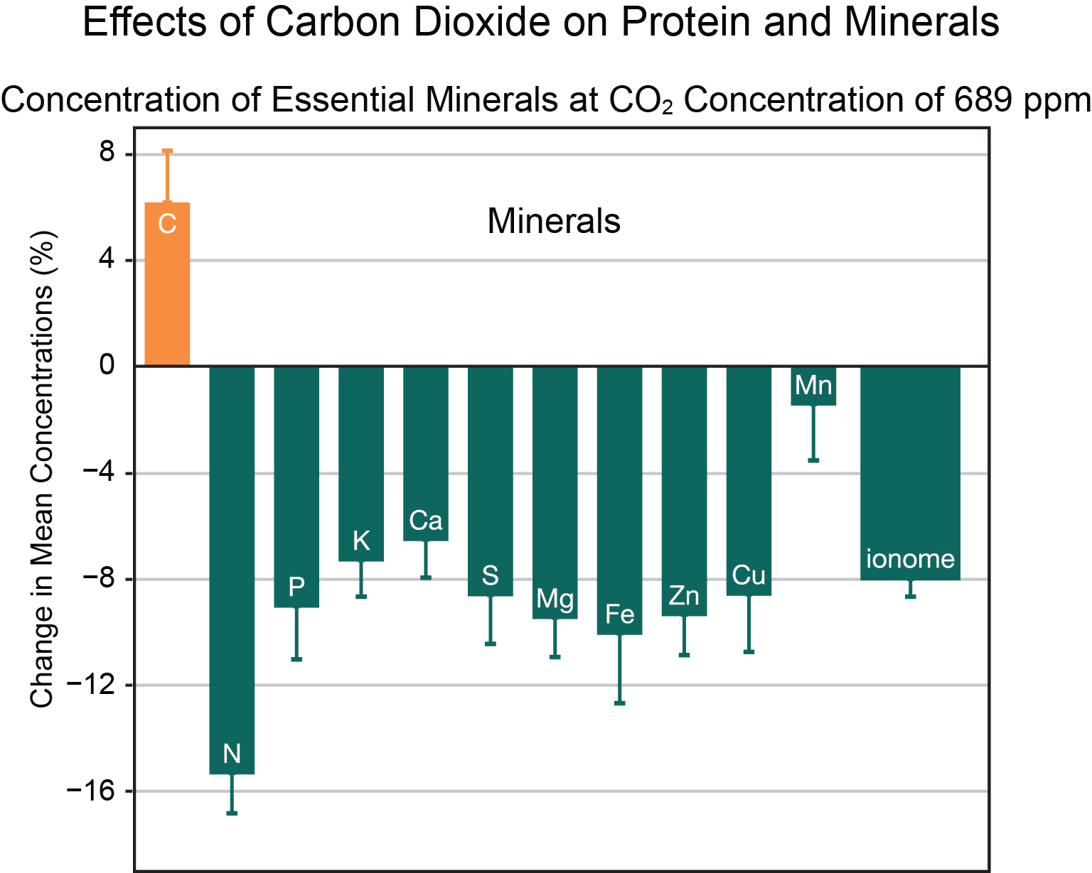
Elevated CO₂ Decreases Crop Iron & Zinc (Myers, Nature, 2014)
Iron Decrease
Zinc Decrease
Wheat: 5.1%
Rice: 5.2%
Soybeans: 4.1%
Children are highest risk group to iron deficiency in U.S.
Affects about 8% of U.S. and 25% of international preschool children.
• Wheat: 9.3%
Rice: 3.3%
Soybeans: 5.1%
Source: Health2016.globalchange.gov
Notes:
Wheat, rice and soybean grown in an elevated CO2 environment also have decreased concentrations of Iron, Zinc and other essential minerals.
This 2014 study from Nature evaluated 143 comparisons of crops grown at 7 FACE facilities in 3 countries (Australia, Japan and US).
Found that wheat, rice and soybean grown at elevated CO2 (550-600 ppm) had lower concentrations of iron content and zinc.
The lower figure on the right shows the average effect on 125 plant species of doubling CO2 concentration from preindustrial levels. This results in decreased concentration of essential minerals and lower protein. The carbohydrate concentration, meanwhile, increases.

Slide 23
What Is A Pediatrician To Do?
Notes:
Given all this information, what is a pediatrician to do? Isn’t this all in the hands of governments and politicians on the global stage?
I hope to convince you all today that we, as pediatricians, are uniquely situated to be a powerful voice for children on the need for climate action.
I’m going to start with a film by Healthcare Without Harm, a leading international organization on environmental responsibility in healthcare.
The film’s narrator is Dr. Aparna Bole, a fellow pediatrician and a member of the AAP’s Council on Environmental Health with me.

Slide 24
Climate Policy Protects Every Child
“Climate change is the biggest global health
threat of the 21st century.”
Lancet Commission on Climate Change, 2009
Source: Freeimages.com
“Tackling climate change could be the greatest global health opportunity of the 21st century.”
Lancet Commission on Climate Change, 2015
Notes:
That film does a beautiful job of portraying the inter-relatedness between healthy children and a healthy environment.
The health implications of a damaged climate have been gaining increasing attention over the past decade.
The Lancet Commission published its first Report, “Managing the Health Effects of Climate Change”, in 2009. This report highlighted the urgent need for a new public health and advocacy movement to bring together public health systems, governments and communities to work towards reducing greenhouse gas emissions and to addressing adverse climate-related health outcomes.
In 2015 the Commission published an updated report, which highlighted, first, that the effects of climate change are being felt today and that it presents a potentially catastrophic risk to human health. And two, that “tackling climate change could be the greatest global health opportunity of the 21st century.” It discusses how many of the needed responses to climate change are “no-regret” options, meaning that they lead directly to other benefits, or “co-benefits”.
(1) reductions in the burden of illness 2) enhanced community resilience 3) the alleviation of poverty 4) global inequity.)

Slide 25
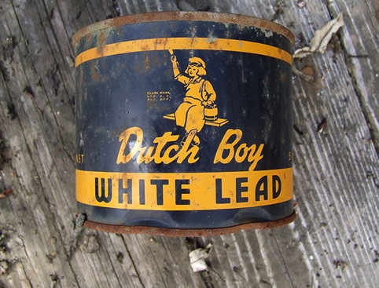
Climate Policy Protects Every Child
Pediatricians have a long
history of advocating for public
health initiatives :
Vaccination programs
Tobacco legislation
Removal of lead from paint and gasoline
Pediatricians have a vital role to play
as a public voice for climate action.
Source: Thester11/Creativecommons
Notes:
Advocating for public health initiatives that protect child health is nothing new to pediatricians.
We have a long history of advocating, for example, for vaccination programs, tobacco legislation, and removal of lead from paint and gasoline.
Success in these initiatives never came easily. It took decades of research, advocacy, and confronting powerful entrenched interests to achieve gains in each of these campaigns. In fact, we continue to fight for legislation to protect children from lead, toxins, and to support vaccination programs.
But these decades of persistence resulted in huge benefits to the health and safety of children.
Today, pediatricians have a vital role to play as a public voice for children on climate action.
Our perspective unites everyone behind a common cause—the health and wellbeing of our children, families, communities.

Slide 26
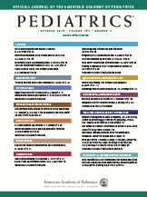
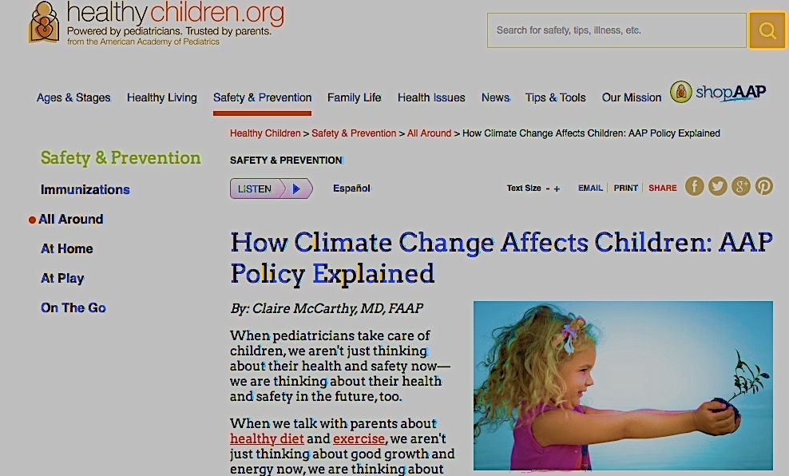
AAP Leadership
•One of first medical organizations to address
health impacts of climate change in 2007.
http://pediatrics.aappublications.org/content/120/5/1149
•Updated Policy Statement and Technical Report
Pediatrics, November, 2015.
http://pediatrics.aappublications.org/content/136/5/992
•Provided written and verbal testimony in support of the
Environmental Protection Agency’s Clean Power Plan.
•Participated in White House Expert Consultation on the
Effects of Climate Change on Children’s Health, 2014.
Notes:
As pediatricians with the AAP, we can be proud to have been one of the first medical organizations to recognize and address the risks that climate change poses to our patients.
The AAP published its first policy statement and technical report on Climate Change and Children’s Health in 2007. Just last year, in November 2015, we published our updated reports in Pediatrics. These reports, as well as related pieces from the AAP News, Blog Posts and a Healthy Children.org page can all be found on the AAP’s website.
The AAP has also been engaged in supporting national policies to reduce greenhouse gas emissions, specifically the EPA’s Clean Power Plan. We provided written and verbal testimony in support of this plan on multiple occasions throughout the hearings process.

Slide 27
AAP Leadership
AAP Consortium On Climate Change Meeting 10/16
Pulmonology, Emergency Medicine, Allergy/Immunology, CME, School Health, Sports Medicine and Fitness, Medical Toxicology, Infectious Diseases, Epidemiology, State Affairs, Psychosocial Aspects Child and Family Health, Ambulatory Medicine, Community Pediatrics, Native American Child Health, Pediatric Trainees, Environmental Health
• Medical Director:
Dr. Jerome Paulson
• Elevating issue in AAP
• Outreach to Districts and State Chapters
• Toolkit
❖ Patient/Physician oriented handouts
❖ PowerPoint Presentation
❖ Sample Op-Ed
Notes:
Just a few weeks ago, the AAP’s consortium on Climate change met for the first time at AAP Headquarters in Illinois.
This consortium consists of a broad representation of AAP committees, councils and sections, including all those listed above.
We established goals for each of the sections, as well as national AAP, in order to increase knowledge amongst pediatricians and families around this issue, increase engagement and advocacy on the state and national level.

Slide 28
Health Leadership
•Medical Society Consortium on Climate and Health
https://medsocietiesforclimatehealth.org
•American College of Physicians Policy Statement and Toolkit
https://www.acponline.org/advocacy/advocacy-in-action/climate-change-toolkit
•American Public Health Association
https://www.apha.org/policies-and-advocacy/public-health-policy-statements/policy-database/2015/12/03/15/34/public-health-opportunities-to-address-the-health-effects-of-climate-change
•Centers for Disease Control and Prevention
http://www.cdc.gov/climateandhealth/default.htm
•U.S. Global Change Research Program, Climate and Health
https://health2016.globalchange.gov/
Notes:
Doctors from across the spectrum of specialties are coming together to work collectively to reduce greenhouse emissions and increase climate readiness.
In April of this year, 9 of the country’s leading medical organizations formed a new Medical Consortium on Climate Change, These organizations are working together to amplify the public health message and advocacy efforts, and producing and sharing statements, toolkits and webinars to educate and engage their members.
Governmental organizations, like the CDC and U.S. Global Change Research Program are very actively engaged in research and outreach on climate and health outcomes, and have excellent resources online.

Slide 29
In Your Practice
Climate Policy is Health Policy
Discuss Co-Benefits With Families
Source: CDC.gov
Walking/biking promotes fitness and reduces emissions.
Plant-based proteins improve cardiovascular health and reduce agricultural pollutants.
Fuel-efficient vehicles and public transportation use save money and reduce emissions.
Notes:
In our practices, I think it can be helpful to recognize that actions and policies that are good for the climate also are generally good for child health.
We can incorporate these co-benefits in to the dischssions we are already having with families.
For example,
“Eating vegetarian sometimes is good for cardiovascular health and is easier on the environment.”

Slide 30
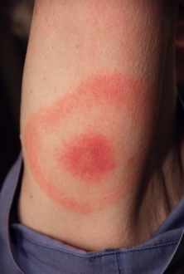
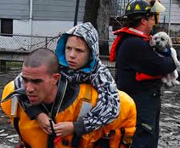
In your practice
Anticipate earlier/longer allergy season
Be alert for shifting timing/locations
of infections
Monitor for mental health effects after
extreme events
Advise parents/coaches on heat precautions
Notes:
In our practices, we can prepare for and anticipate climate associated effects on our patients.
We can anticipate earlier onset and longer duration of the pollen allergy season.
We should observe for climate sensitive infections, like vector borne illness, and watch for their appearance outside of the typical season or location.
When our communities are affected by extreme weather events, we need to watch for mental health effects, such as depression, anxiety or PTSD, as well as declining school performance.
And we should protect all children, but particularly our athletes and young infants, from extreme heat.

Slide 31
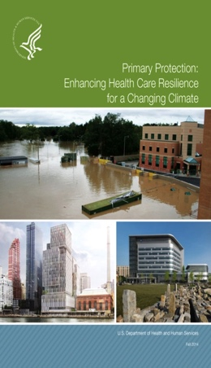
Green Your Facility
•Promote alternatives to single occupancy car commuting
•Reduce Energy Usage
Resource: https://practicegreenhealth.org/
Efficient buildings and products
Consider renewable energy generation or purchase
•Reduce Waste and Recycle
Resource: Health Care without Harm
•Increase Climate Resilience
Resource: toolkit.climate.gov
Bike Shop at
Seattle
Children’s
Hospital
Source: http://pulse.seattlechildrens.org
Wind Turbines Help
Power Gundersen
Health System
Source: http://www.gundersenhealth.org
Notes:
Doctors can also work with their institutions, including offices and hospitals, to reduce our own carbon footprints.
We can provide incentives to employees to bike, walk or use public transportation to get to work.
Seattle Children’s Hospital has a great model program for incentivizing biking. Pay their staff to bike to work, and they have their own, on-site bike shop for employees, with free maintenance.
We can reduce energy use in our facilities, through maximizing efficiency and reducing waste, as well as developing on-site renewable power generation or purchasing of green power.
Gundersen Health System in Wisconsin was the first health system in the nation to become energy independent. This image is of installation of a wind turbine in one of their wind energy projects.
We can reduce waste, whether it is in our operating rooms or offices, and reuse and recycle materials whenever possible.
And we need to improve the climate resilience of our healthcare facilities, through identifying and minimizing vulnerabiities that threaten our assets and our patients.

Slide 32
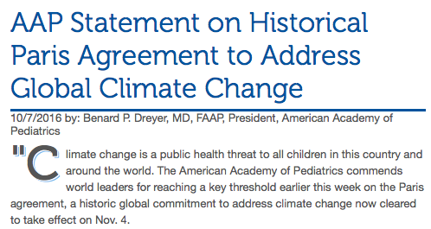
Advocate
Become a public voice for
climate action:
Support policies that reduce greenhouse gas emissions
Educate elected officials
Work with state chapters
and schools of public health
Write op-eds and letters to the editor
Share stories through social media
￼
Notes:
Healthcare providers can be a powerful public voice for climate action.
We can support policies that reduce greenhouse gas emissions.
We can educate elected officials on the risks that climate change poses to public health
We can work with our state chapters and schools of public health to influence state policy and increase education and preparation for climate-related health impacts
We can provide expert testimony, write letters to the editor, Op-Eds, or share related stories on social media or our office website or Facebook pages.

Slide 33
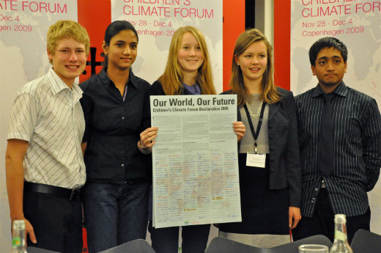
Children Need Us Their Doctors Their Voice
Youth delegates show their finalized Declaration during the Children’s Climate Forum in Copenhagen. ©UNICEF/NYHQ2009-2183/Pires
Notes:
In summary
Children bear the greatest burden of climate associated health impacts.
They also have the most at stake. Their future stands in the balance. But they have no voice, no vote.
As pediatricians, it is our mission to speak for children on the issues that affect their health and prosperity.
We need to speak loudly for children on climate change, so that they have the opportunity to raise their own families on a planet that is as safe, as productive, and as beautiful as the one we have enjoyed.

Slide 34
Protect Every Child
Climate change is happening and affecting every child
Tackling climate change today protects every child
Climate change presents an unprecedented opportunity for every pediatrician to protect every child
Notes:
I will conclude my presentation with this final message.
Climate change is happening today, and it is affecting EVERY CHILD.
By reducing greenhouse gas emissions and increasing our preparedness today, we can protect EVERY CHILD
Climate change, therefore, presents an unprecedented opportunity to pediatricians. An opportunity for every pediatrician to protect the life, the health and the future of EVERY CHILD.

